Slide 1
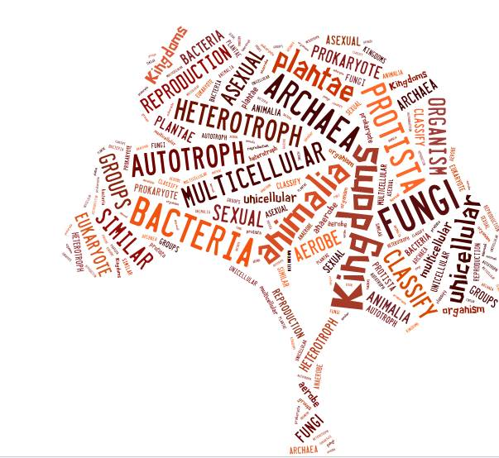
Intro to Classification

Slide 2
The Kingdom System
Has become more complex as scientists gather new information about living things.
1753 Animalia & Plantae | 1866 Animalia; Plantae; Protista | 1938 Animalia; Plantae; Protista Monera | 1959 Animalia; Plantae; Protista Monera Fungi | 1977 Animalia; Plantae; Protista Fungi Bacteria Archaea

Slide 3
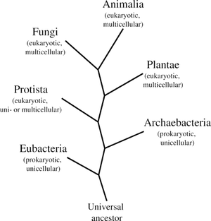
THE SIX KINGDOMS
Organized by…
1) Cell type
2) Ability to obtain food (auto-/heterotroph)
3) Number of cells

Slide 4
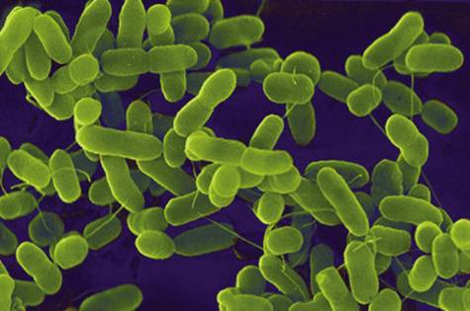
THE SIX KINGDOMS
EUBACTERIA:
Prokaryotic
Single-celled
Autotrophic/ Heterotrophic
EX: E.coli, Streptococcus, yogurt bacteria

Slide 5
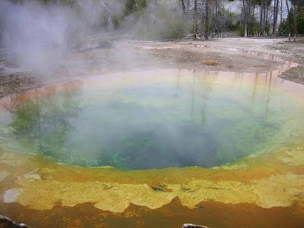
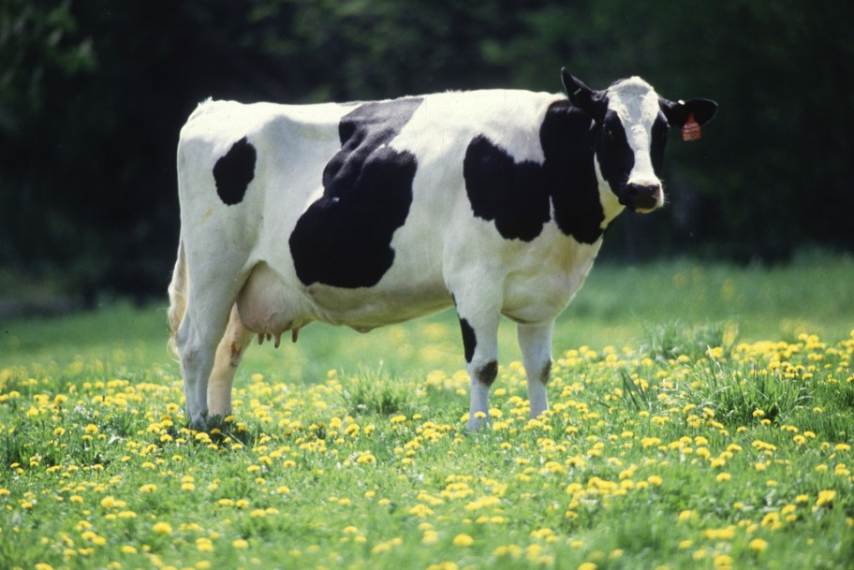
THE SIX KINGDOMS
ARCHAE-BACTERIA:
Prokaryotic
Single-celled
Autotrophic/ Heterotrophic
Bacteria that are found in extreme habitats

Slide 6
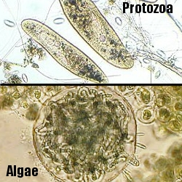
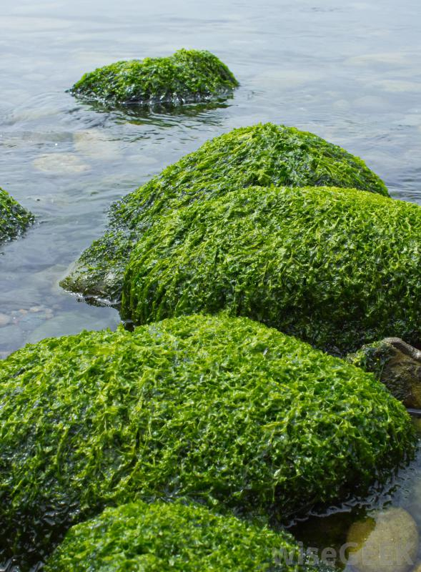
THE SIX KINGDOMS
PROTISTA:
Eukaryotic
Single- (or multicellular)
Autotrophic/ Heterotrophic
Anything that is not a plant, animal or fungi!

Slide 7
THE SIX KINGDOMS
2nd largest!
PLANTAE:
Eukaryotic
Multicellular
Autotrophic
Ex: trees, moss, flowers, etc.

Slide 8
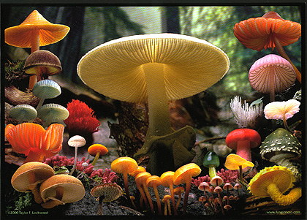
THE SIX KINGDOMS
FUNGI:
Eukaryotic
Multicellular
Heterotrophic –decomposers, parasites
Different life cycle from animals.

Slide 9
THE SIX KINGDOMS
THE largest!
ANIMALIA:
Eukaryotic
Multicellular
Heterotrophic
EX: You, me, insects, dogs, fish, etc.

Slide 10
Dichotomous Key
A simple system to differentiate between different organisms/items.
Give the user two descriptions and asks them to make a choice.

Slide 12
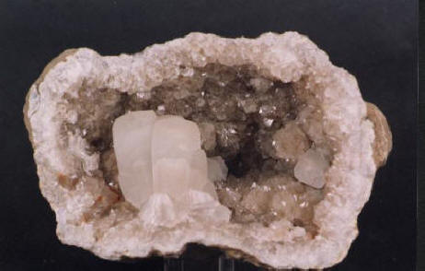
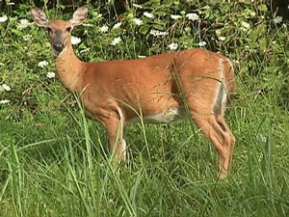
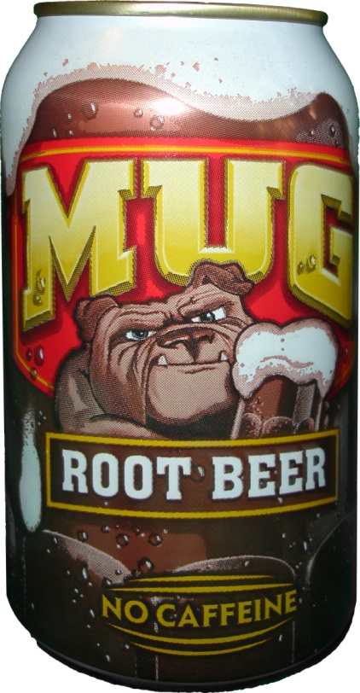
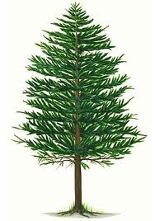
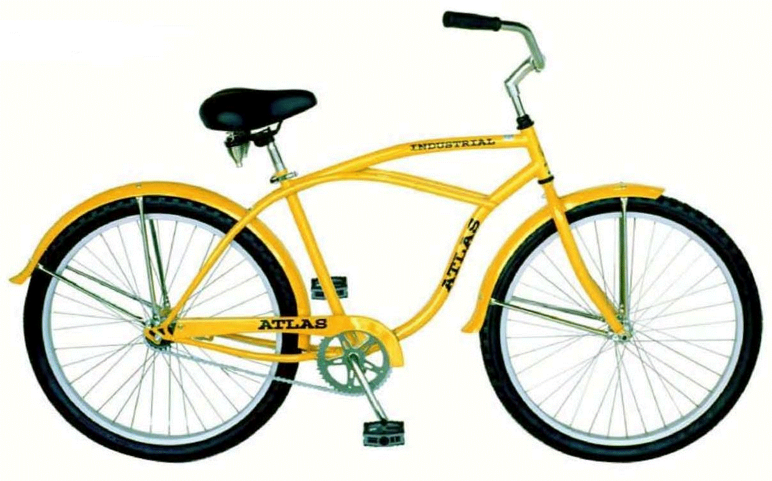
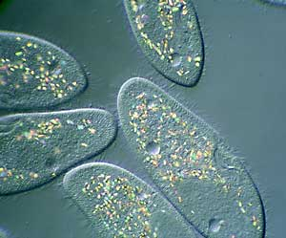
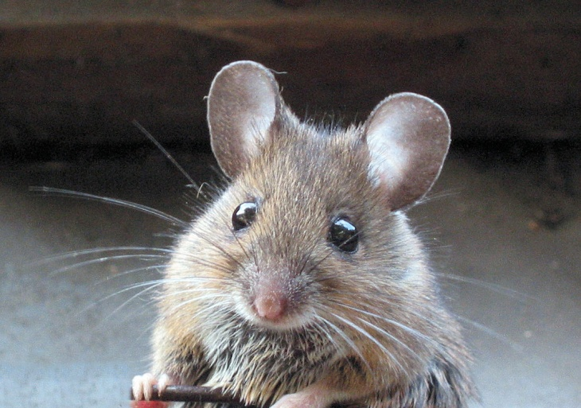

Slide 13
Living OR Nonliving?

Slide 14
Deal with one group at a time
1a. Organism is living……………
1b. Organism is nonliving……. Go to 2.
2a.
2b.

Slide 15
Divide into 2 groups again!

Slide 16
Divide into 2 groups again!
Metallic?
Nonmetallic?

Slide 17
1a. Organism is living……………
1b. Organism is nonliving……. Go to 2.
2a. Object is metallic……….. Go to 3.
2b. Object is nonmetallic…… Geode (a rock)
3a.
3b.

Slide 18
Divide into 2 groups again!
Wheels or
No Wheels?

Slide 19
Now Finish Here
1a. Organism is living……………
1b. Organism is nonliving……. Go to 2.
2a. Object is metallic……….. Go to 3.
2b. Object is nonmetallic…… Geode (a rock)
3a. Object has wheels…….. Bike
3b. Object does not have wheels….. Soda Can

Slide 20
LET’S TRY ANOTHER ONE!
I need seven volunteers!

