Slide 1
Lipids & Carbohydrates

Slide 2
Macromolecules
Large molecules
4 major macromolecules found in the body
Lipids
Carbohydrates
Nucleic Acids
Amino Acids

Slide 3
Macromolecules
Large molecules
4 major macromolecules found in the body
Lipids
Carbohydrates
Nucleic Acids
Amino Acids
Made mostly of carbon (also oxygen, hydrogen)

Slide 4
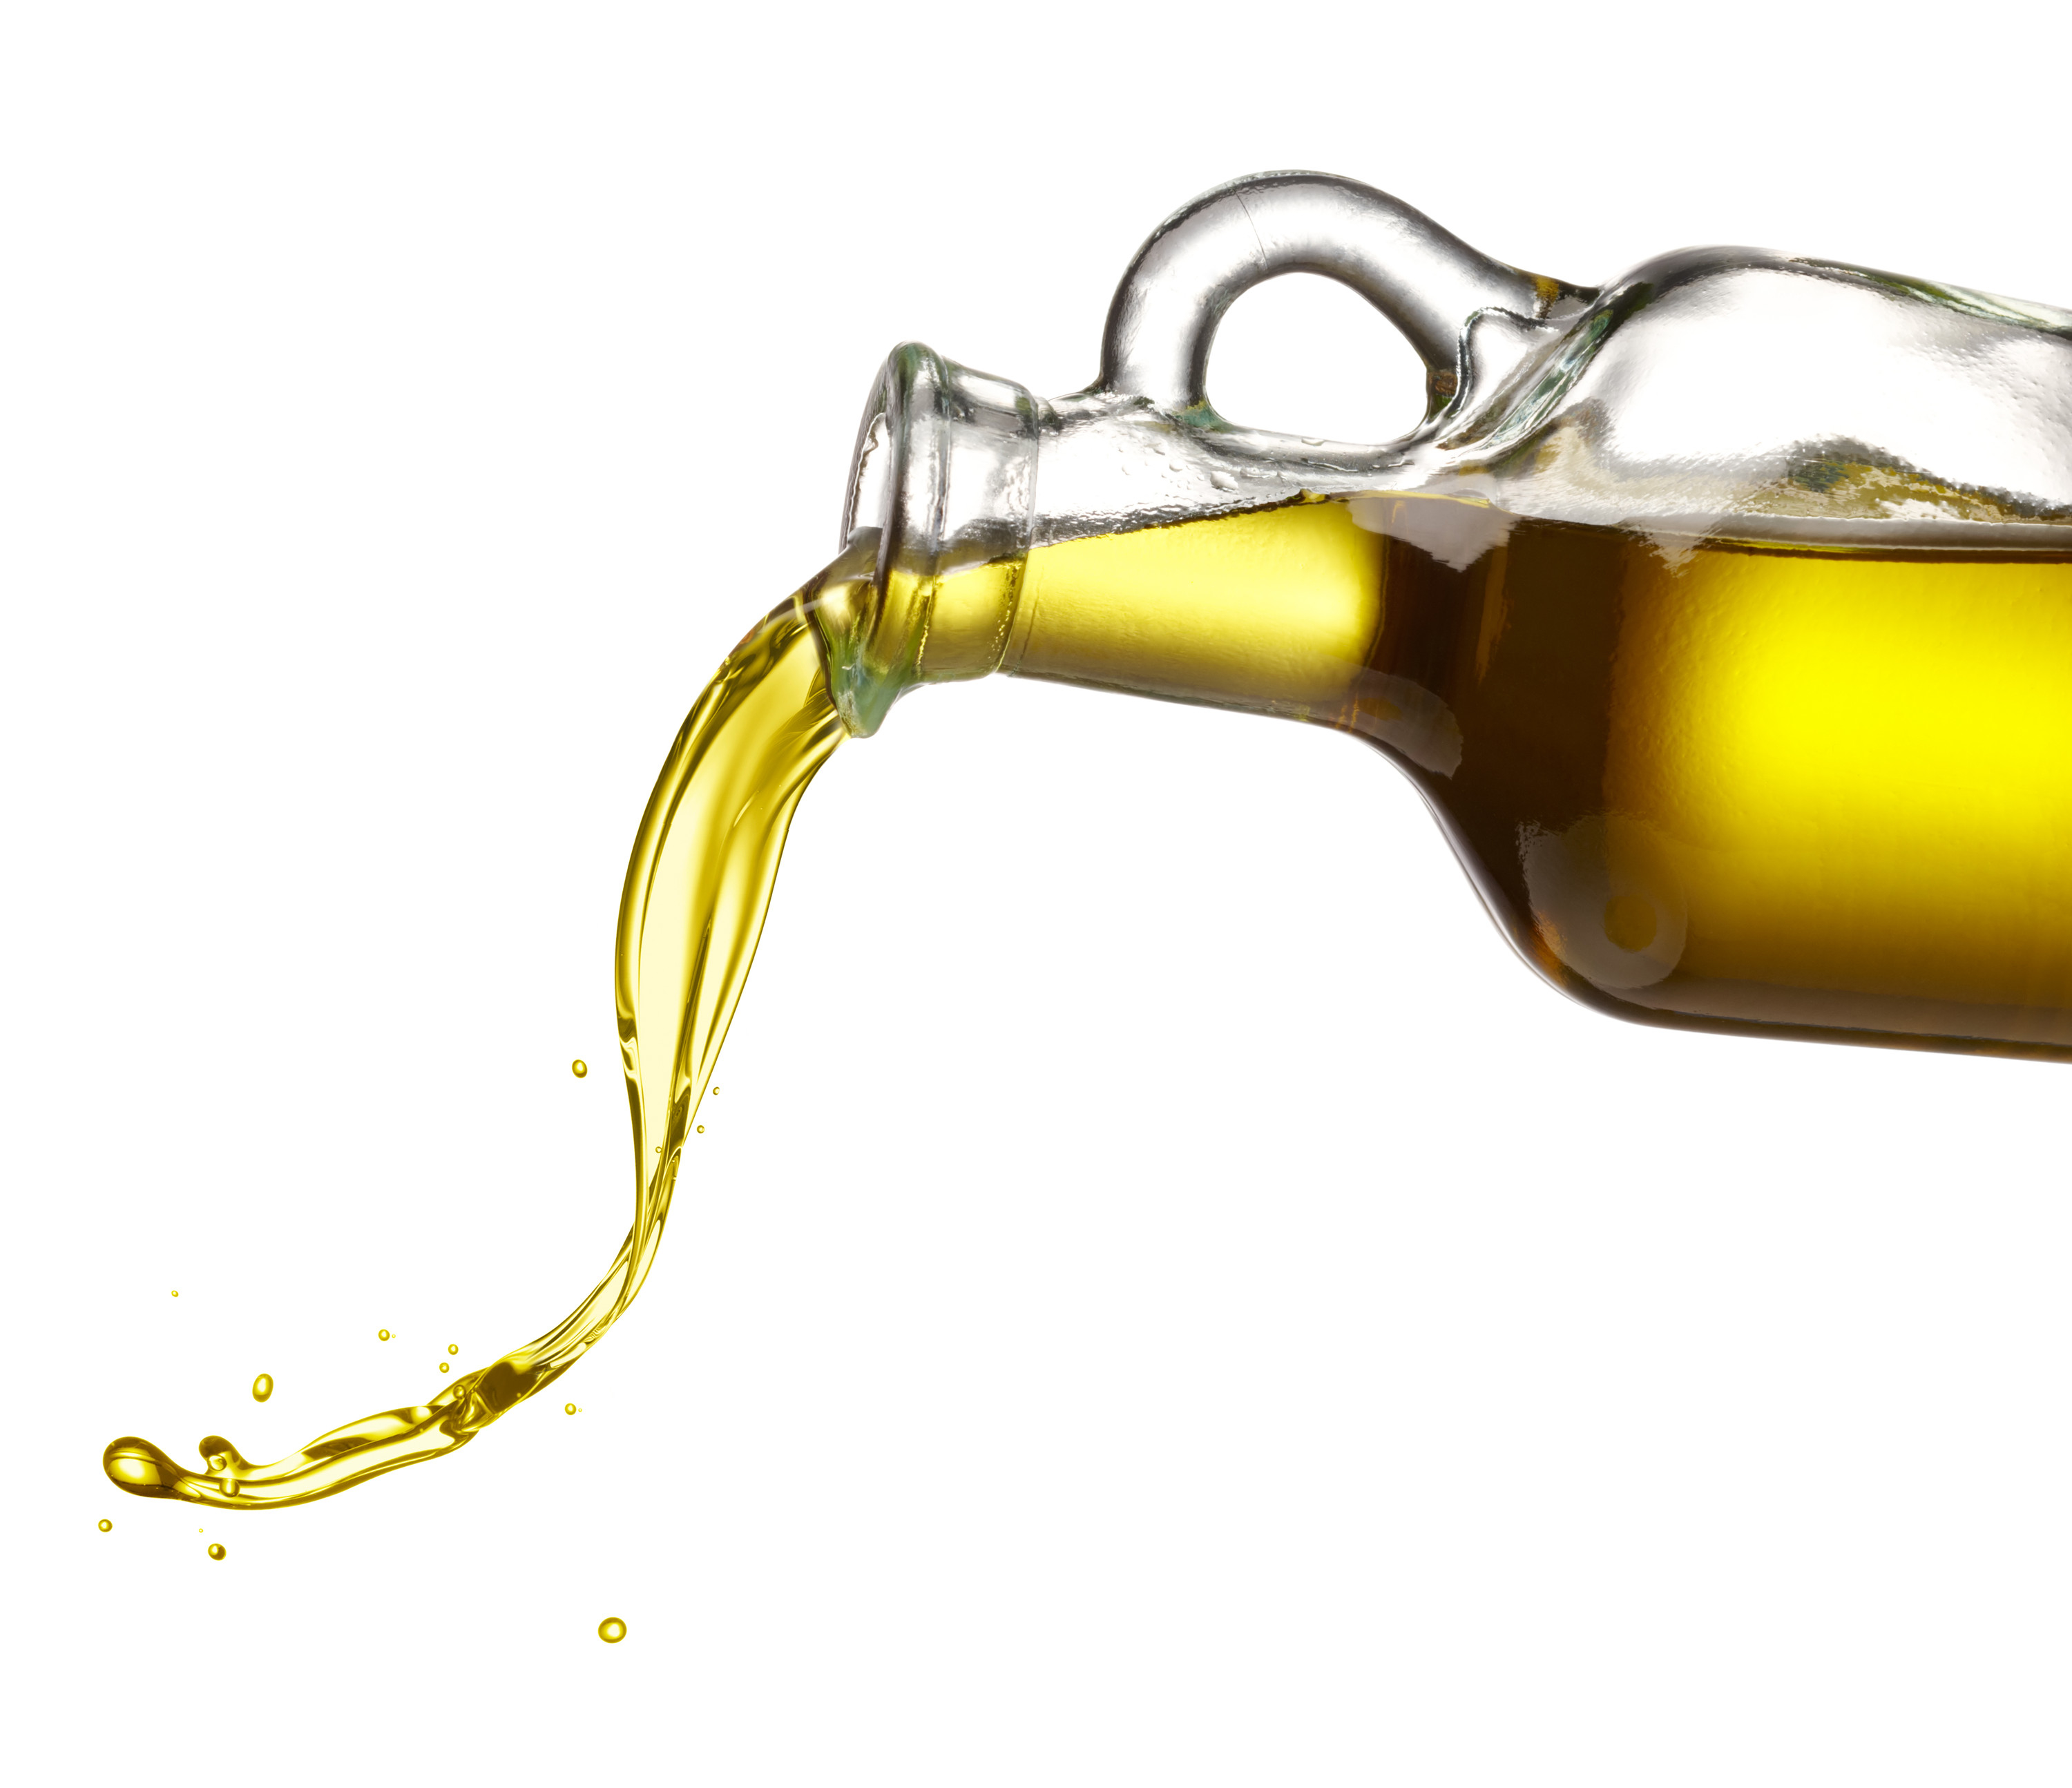
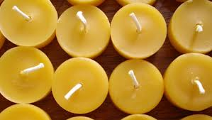
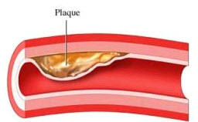
Lipids
AKA fats
Examples
Oils
Waxes
Plaque

Slide 5
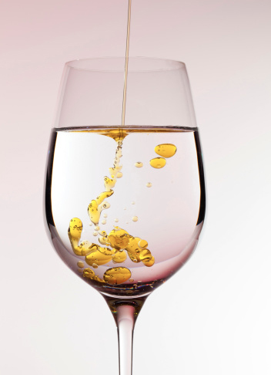
Lipids are hydrophobic
Hydro- = water
-phobic = fear of
Water and lipids don’t like to mix!

Slide 6
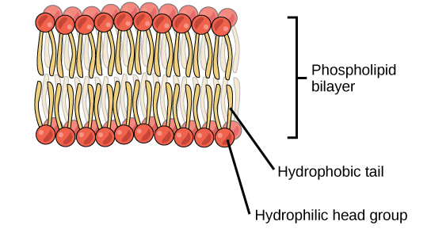
Lipids are hydrophobic
Hydro- = water
-phobic = fear of
Water and lipids don’t like to mix!
Things that like water are hydrophilic
Hydro- = water
-philic = love of

Slide 7
Lipids are hydrophobic
Hydro- = water
-phobic = fear of
Water and lipids don’t like to mix!
Things that like water are hydrophilic
Hydro- = water
-philic = love of

Slide 8
Lipid structure
Fatty acids + Glycerol
Neutral charge
Long chains of carbon and hydrogen

Slide 9
Carbohydrates
AKA sugars
Examples
White sugar
Complex carbs
Starch

Slide 10
Carbohydrate structure
Monosaccharide
Mono- = one
-saccharide = sugar
Example: glucose
Carbon ring
-ose
signifies a sugar molecule

Slide 11
Carbohydrate structure
Disaccharide
Di- = two
-saccharide = sugar
Example: sucrose
2 different sugar molecules linked together

Slide 12
Carbohydrate structure
Polysaccharide
Poly- = many
-saccharide = sugar
Example: starch
Many glucose molecules linked together
Method for storing energy for later
Sugar
Sugar
Sugar
Sugar
Sugar

Slide 13
Chemical energy
Lipids and carbohydrates have lots of stored energy.
Breaking bonds within macromolecules releases energy.
Sugar
Sugar
Sugar
Sugar
Sugar

Slide 14
Chemical energy
Lipids and carbohydrates have lots of stored energy.
Breaking bonds within macromolecules releases energy.
“Building block” molecules are called monomers.
Sugar
Sugar
Sugar
Sugar
Sugar

Slide 15
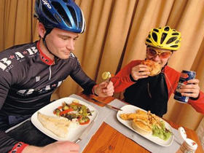
Types of energy
Short-term energy from simple carbohydrates
Digested quickly
Long-term energy from polysaccharides and fats
Digested slowly

