Slide 1
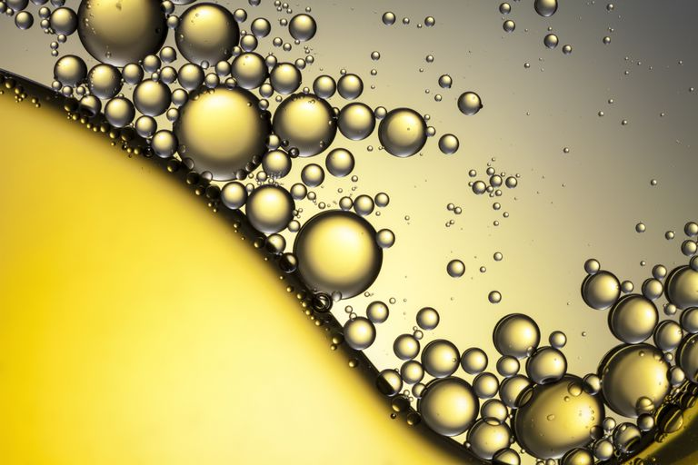
Lipids

Slide 2
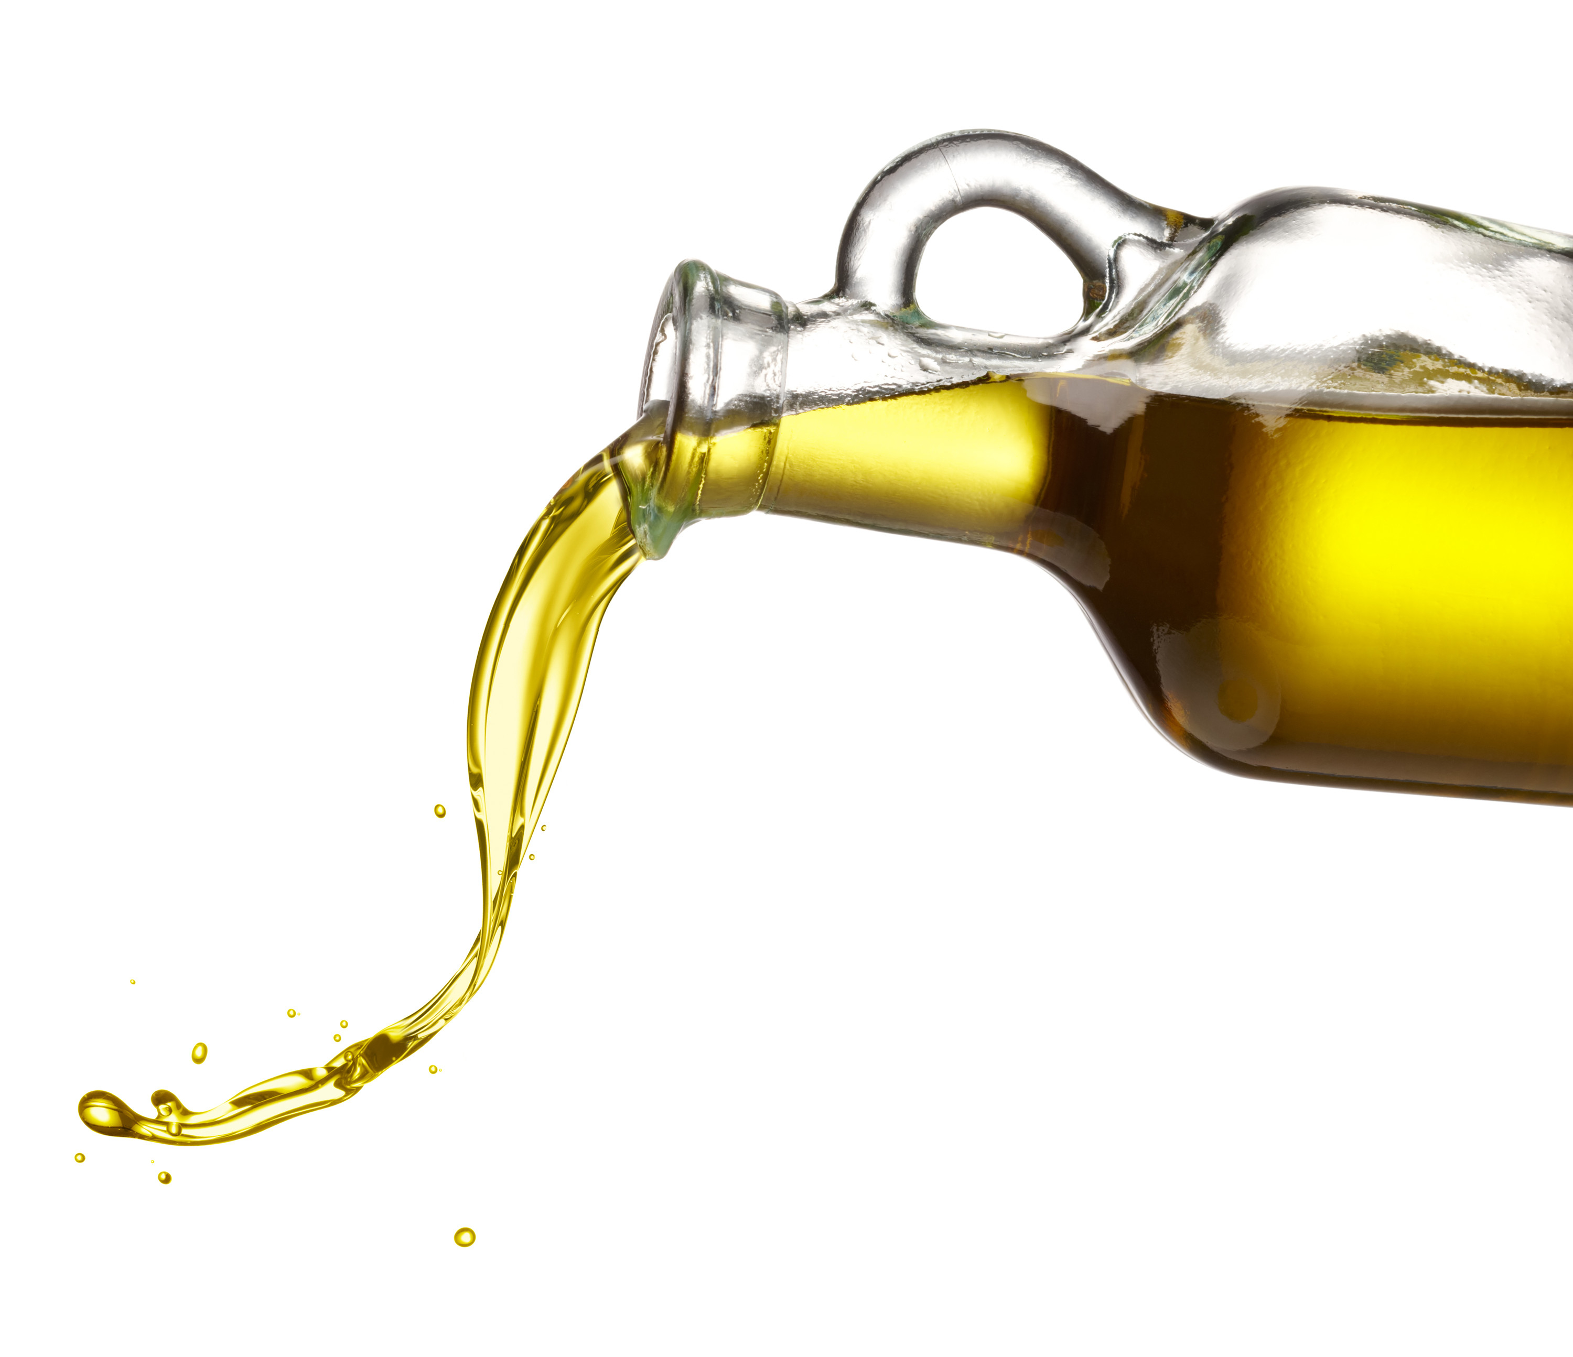
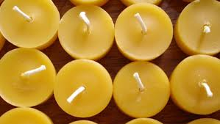
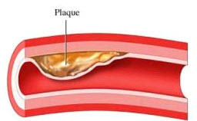
Lipids
AKA fats
Examples
Oils
Waxes
Plaque

Slide 3
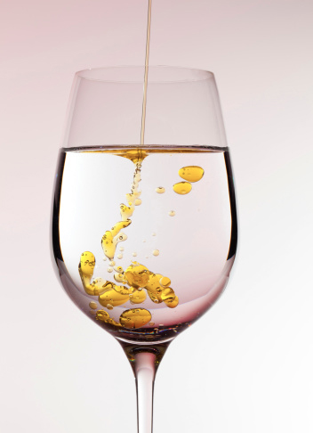
Lipids are hydrophobic
Hydro- = water
-phobic = fear of
Water and lipids don’t like to mix!

Slide 4
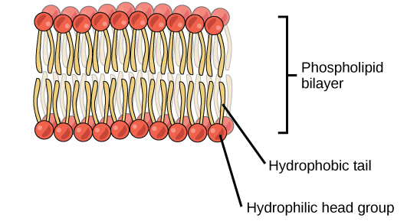
Lipids are hydrophobic
Hydro- = water
-phobic = fear of
Water and lipids don’t like to mix!
Things that like water are hydrophilic
Hydro- = water
-philic = love of

Slide 5
Lipids are hydrophobic
Hydro- = water
-phobic = fear of
Water and lipids don’t like to mix!
Things that like water are hydrophilic
Hydro- = water
-philic = love of

Slide 6
Lipid structure
Fatty acids + Glycerol
Neutral charge
Long chains of carbon and hydrogen

Slide 7
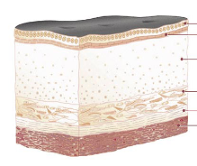
Lipid function
Long-term energy storage
Protection of organs
Insulation

