Slide 1
Marfan Syndrome
By Jared Bowen-Kauth

Slide 2
Introduction

Slide 3
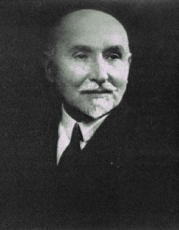
Introduction
Disorder that affects the connective tissue in many parts of the body.
Named after Antoine Marfan, the French doctor who discovered it in 1896
Affects men and women of all races and ethnic groups
About 1 in 5,000 people have Marfan syndrome, making this a fairly rare disease

Slide 4
Description

Slide 5
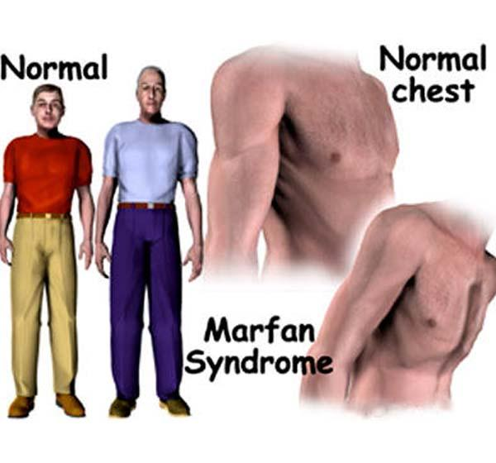
Symptoms
Abnormal facial appearance
Eye problems such as nearsightedness
Crowding of teeth
Tall, thin body
Abnormally shaped chest
Long arms, legs, and fingers
Poor healing of wounds or scars on the skin

Slide 6
Signs That Someone Has This Disorder
Some signs are easy to detect...
Tall and thin body type
Curved spine
Flexible joints
Flat feet
Stretch marks on the skin that are not related to weight gain or loss

Slide 7
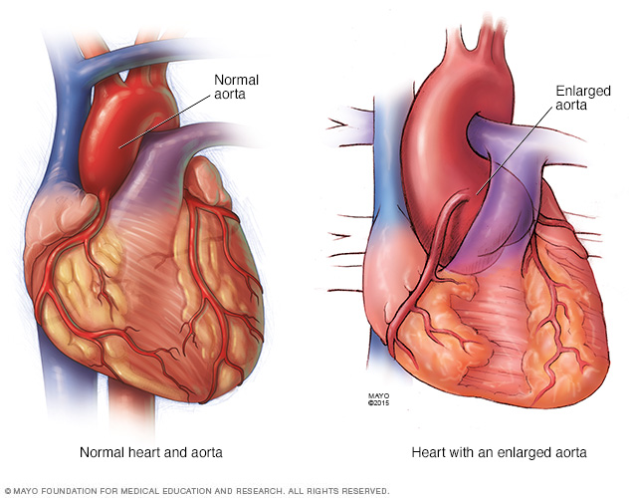
Signs That Someone Has This Disorder
Other signs are harder to detect…
Heart problems, especially those related to the aorta
Aortic enlargement
Sudden lung collapse
Eye problems (nearsightedness, dislocated lens, detached retina, early glaucoma, and early cataracts)

Slide 8
Prognosis
Most children with Marfan syndrome can expect to live long lives.
Some features of Marfan syndrome, like those affecting the heart and blood vessels, bones or joints, can get worse over time.

Slide 9
Inheritance

Slide 10
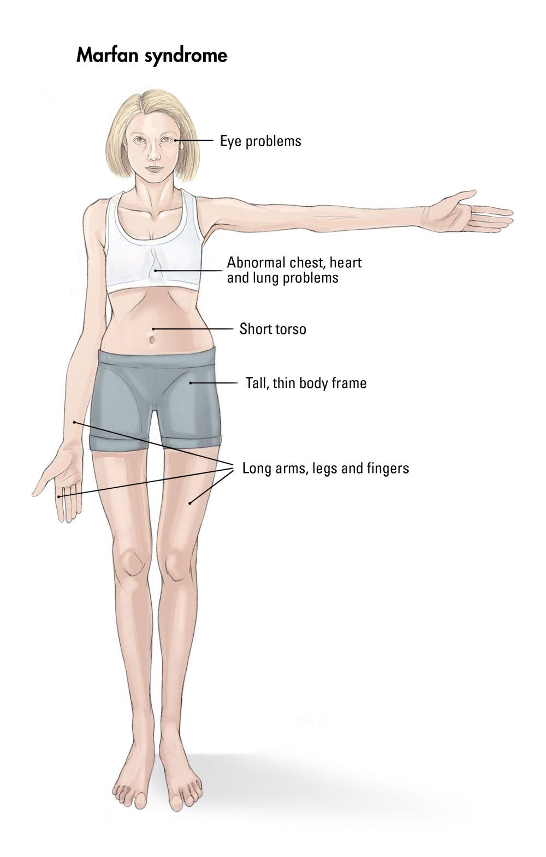
Mutations
Mutations in the fibrillin 1 gene (FBN1) gene cause Marfan syndrome.
Large gene (65 exons) located at chromosome 15q-21.1.
The FBN1 gene provides instructions for making a protein called fibrillin-1.
Fibrillin binds with other proteins to form microtubules.
Microfibrils become part of the fibers that provide strength and flexibility to connective tissue.

Slide 11
Mutations
A mutation in the FBN1 gene can reduce the amount of functional fibrillin-1 that is available to form microfibrils, which leads to decreased microfibril formation.
As a result, excess growth factors are released and elasticity in many tissues is decreased, leading to overgrowth and instability of tissues.

Slide 12
Mode of Inheritance
This condition is inherited in an autosomal dominant pattern, which means one copy of the altered gene in each cell can cause the disorder.
If you have the condition, you have a 50 percent chance of passing the altered gene to each of your children.
At least 25 percent of Marfan syndrome cases result from a new mutation in the FBN1 gene. These cases occur in people with no history of the disorder in their family.

Slide 13
Rare Cases
No mutation in FBN1 is identified.
Complete allele deletion
More complex rearrangements
Alterations in regulatory sequences involving the FBN1 gene

Slide 14
Treatment

Slide 15
Treatment
Marfan syndrome has no cure. However, treatments can help delay or prevent complications, especially when started early.
Medicines are used to try to slow the rate of aortic dilation. Surgery is used to replace the dilated segment of aorta before it tears.
If you have scoliosis (a curved spine), your doctor may suggest a brace or other device to prevent the condition from getting worse.
Glasses or contact lenses

Slide 16
Prevention

Slide 17
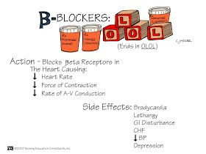
Prevention
Doctors often prescribe blood pressure lowering drugs to help prevent the aorta from enlarging and to reduce the risk of dissection and rupture.
The most commonly used drugs are beta blockers, which cause your heart to beat more slowly and with less force.

Slide 18
Screening Test
Echocardiogram, which uses sound waves to capture real-time images of your heart in motion.
Checks the condition of your heart valves and the size of your aorta.
Computerized tomography (CT) scans and Magnetic resonance imaging (MRI).

Slide 19
Famous People with Marfan syndrome
Bradford Cox
Tutankhamen
Abraham Lincoln
Michael Phelps
Osama Bin Laden

Slide 20
Works Cited
How is Marfan syndrome treated? (2010, October 1). Retrieved November 15, 2016, from
http://www.nhlbi.nih.gov/health/health-topics/topics/mar/treatment
Marfan syndrome. (2016, November 15). Retrieved November 15, 2016, from https://ghr.nlm.nih.gov/condition/marfan-syndrome#
Marfan syndrome. (2016). Retrieved November 15, 2016, from http://www.massgeneral.org/conditions/condition.aspx?id=624
Mayo Clinic Staff. (2016, March 10). Marfan syndrome. Retrieved November 15, 2016, from
http://www.mayoclinic.org/diseases-conditions/marfan-syndrome/home/ovc-20195407

Slide 21
Works Cited
What is Marfan syndrome? (2014). Retrieved November 15, 2016, from https://www.marfan.org/about/marfan
Wright, M. J., MBChB, MSc, & Connolly, H. M., MD, FASE. (2016, November 2). Genetics, clinical features, and diagnosis of Marfan
syndrome and related disorders. Retrieved November 15, 2016, from https://www.uptodate.com/contents/genetics-clinical-features-and-diagnosis-of-marfan-syndrome-and-related-disorders?source=search_result&search=marfan%2Bsyndrome&selectedTitle=1~118

