Slide 1
Bell Ringer
You are a scientist observing two different birds of the same species. Bird A lives a long life without ever mating. Bird B is killed soon after mating. Which bird would you consider to be the most successful biologically? Defend your answer.

Slide 3
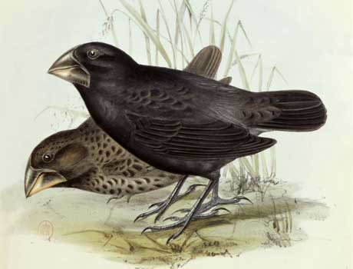
Darwin and natural selection
Notes:
Bell questions: What are acquired traits? Examples. What are inherited traits? Examples.

Slide 4
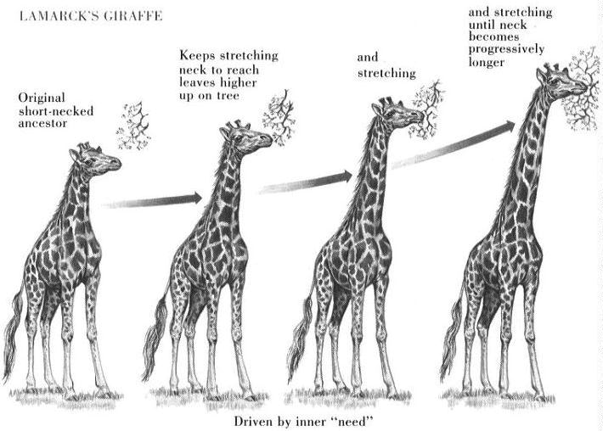
Before Darwin…
Jean-Baptiste Lamarck
Inheritance of acquired traits

Slide 6
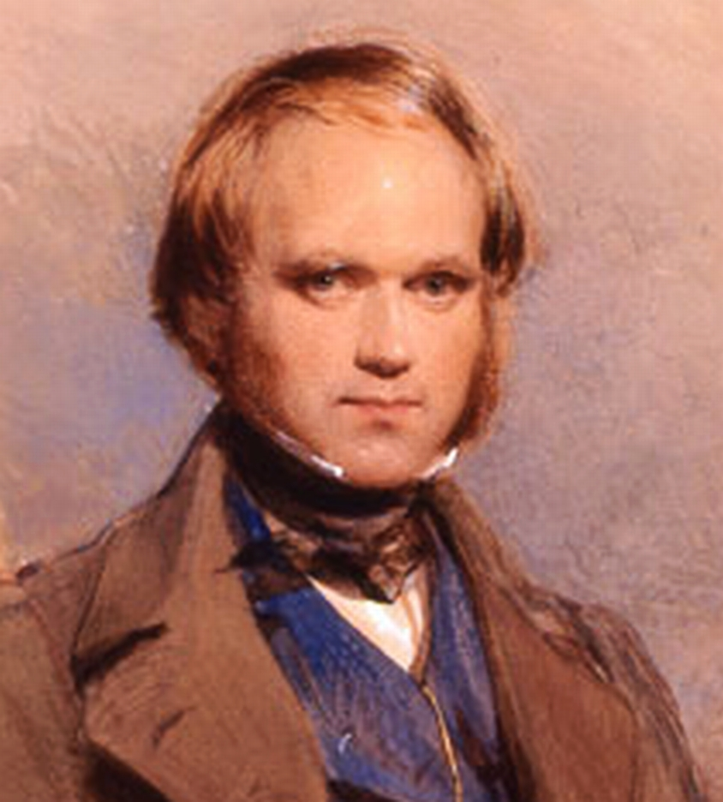
Charles darwin (1809 – 1882)
British naturalist
Proposed a method for how organisms develop adaptations that can lead to separate species
Natural Selection
“Survival of the fittest!”

Slide 7
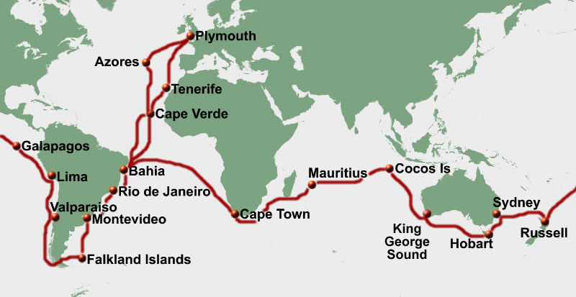
Voyage of the HMS Beagle (1831-1836)
Traveled around the world
Capt. Robert Fitzroy
Main mission to chart the South American coastline

Slide 8
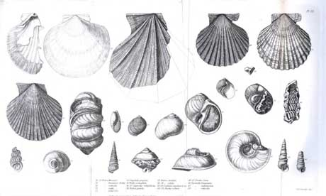
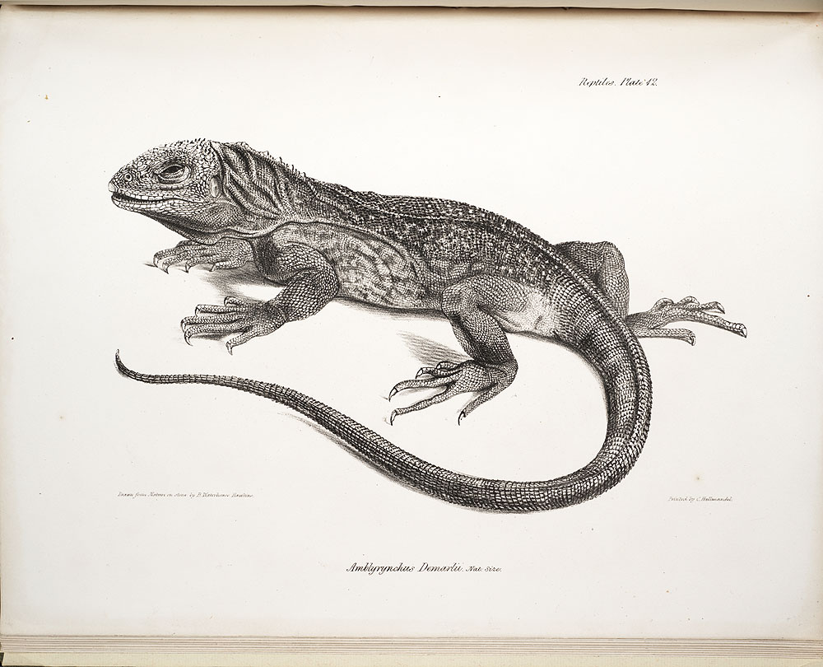
Voyage of the HMS Beagle (1831-1836)
Observed and recorded natural phenomena

Slide 9
Now it’s your turn!

Slide 10
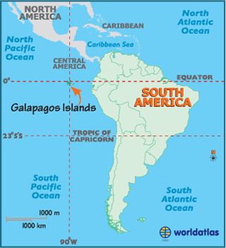
The galapagos islands
Recently formed volcanic islands
Most of the species on the Galapagos live nowhere else in the world
But they look like species living on the mainland!

Slide 11
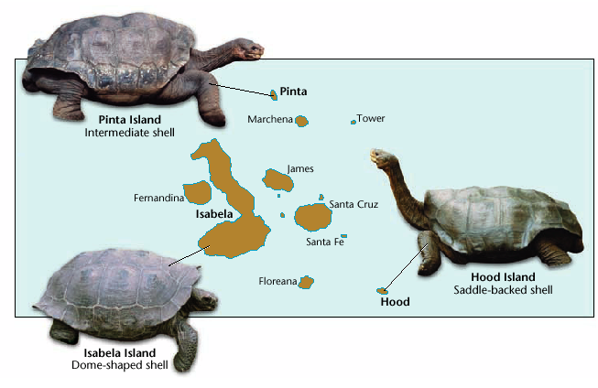
Giant tortoises
Is there a relationship between the environment and what an animal looks like?

Slide 12
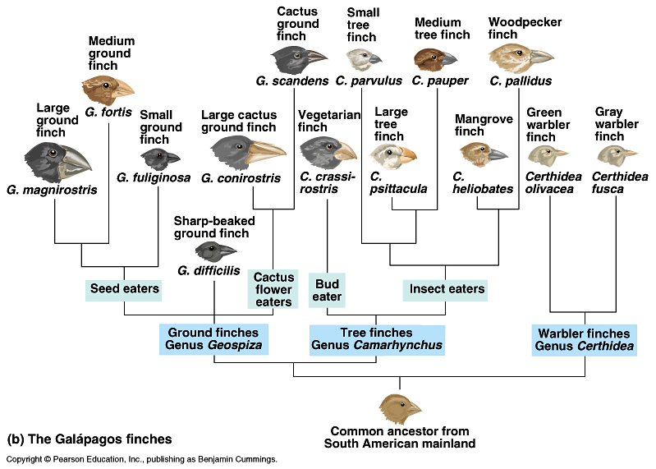
Beak shape & food type

Slide 13
Natural Selection
The process that causes advantageous traits to become more common over time.

Slide 14
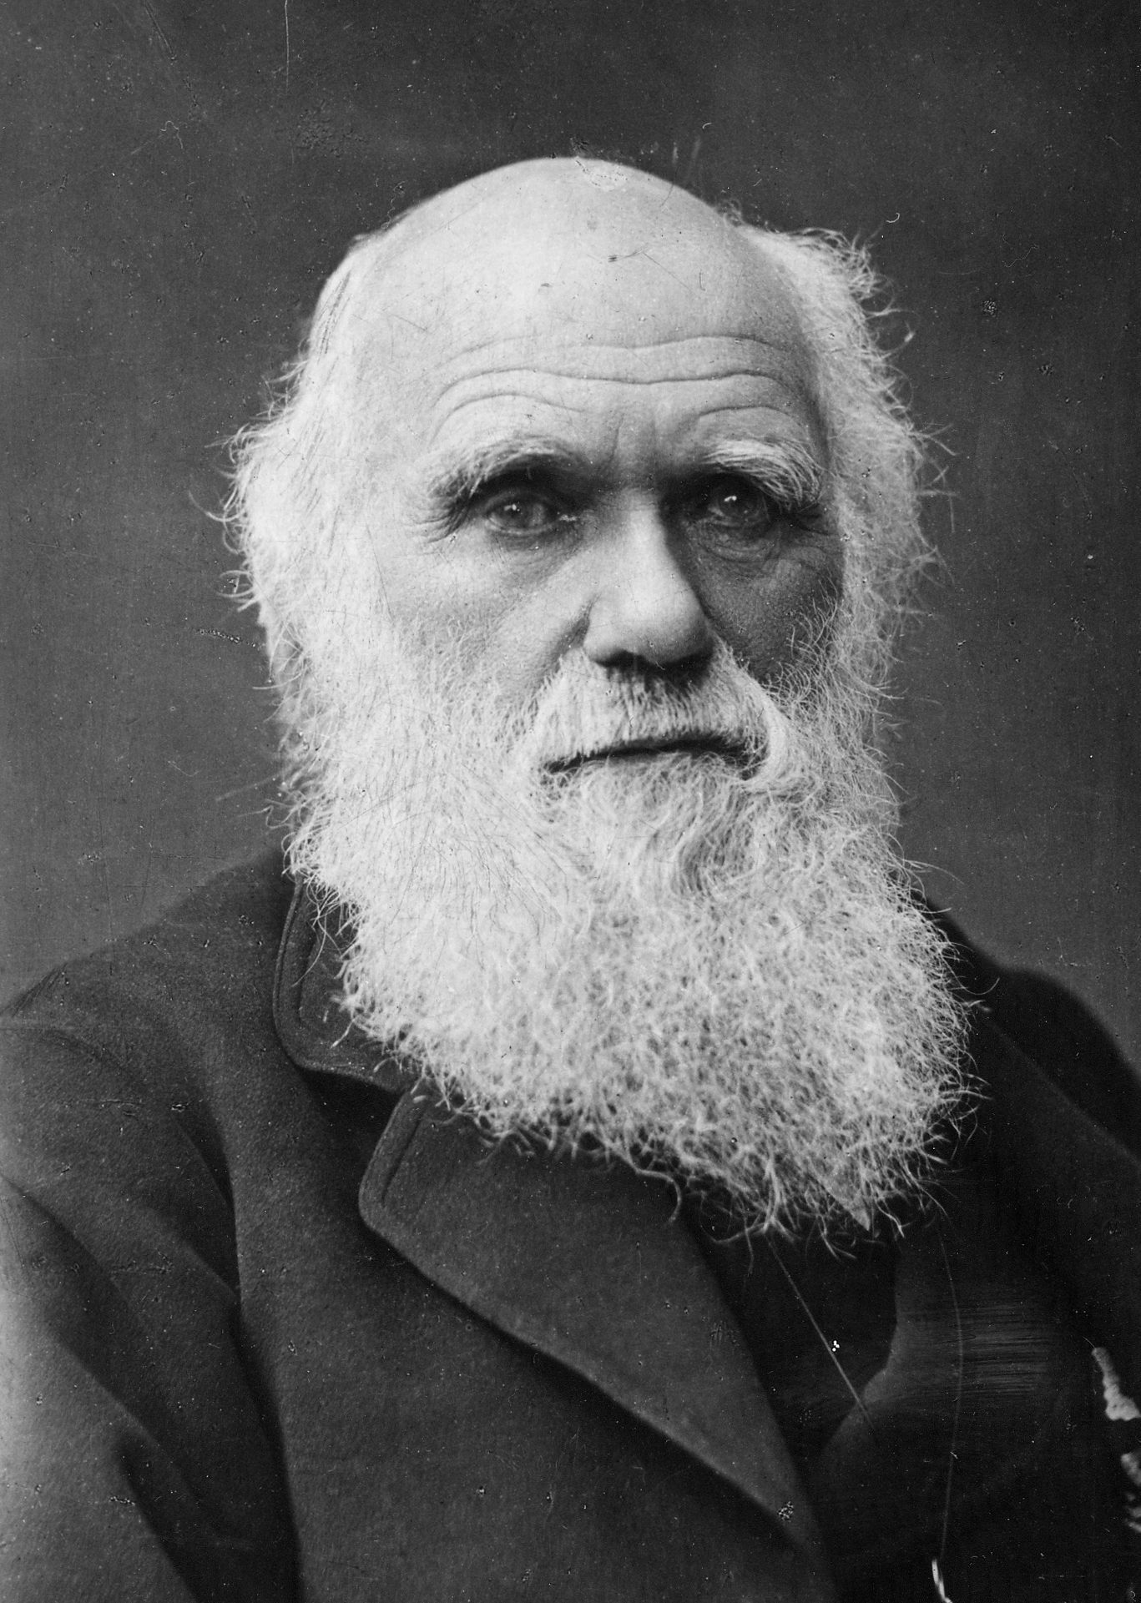
Natural selection is based on…
I concur!
Variation in the Population.
Survival of those suited to environment.
Some survive and reproduce while others don’t due to limited resources.

Slide 15
Natural selection predicts…
Individuals in each generation will differ slightly from members of each previous generation.
Over long periods of time, small differences accumulate to produce new species and eventually major transformations in the history of life.

Slide 16
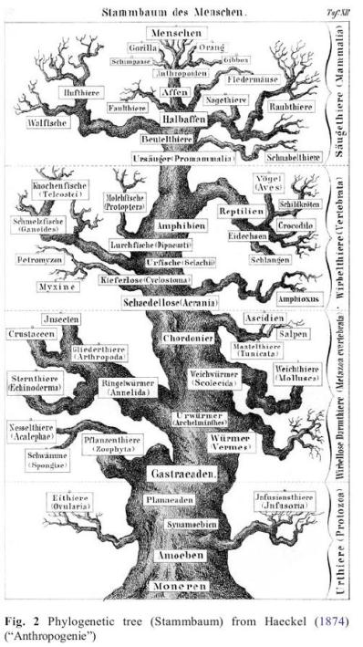
Tree thinking
Darwin uses trees
as a metaphor for
pattern of evolution.
Hierarchical
Growing
Expansion/die-offs
Single common ancestor (trunk)

Slide 17
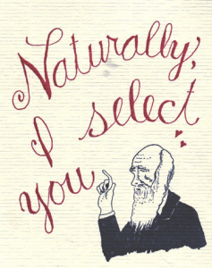
Questions??

