Slide 1
ORGAN & SYSTEM COORDINATION
AP BIOLOGY
UNIT 8: ORGANISM FORM & FUNCTION

Slide 2
Overview: A balancing act
The physiological systems of animals
Operate in a fluid environment
The relative concentrations of water and solutes in this environment
Must be maintained within fairly narrow limits

Slide 3
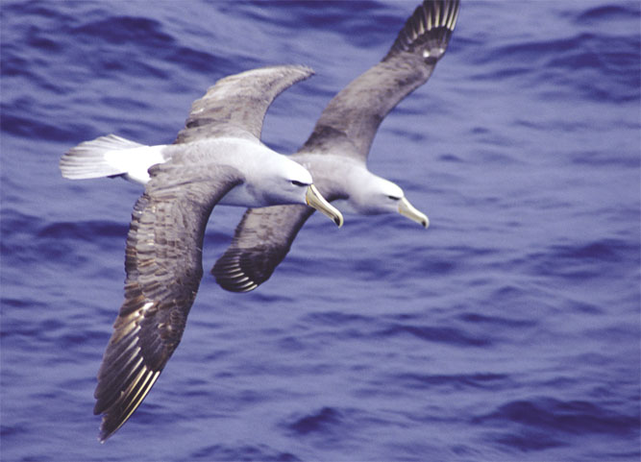
Freshwater animals
Show adaptations that reduce water uptake and conserve solutes
Desert and marine animals face desiccating environments
With the potential to quickly deplete the body water
Figure 44.1

Slide 4
Osmoregulation
Regulates solute concentrations and balances the gain and loss of water
Excretion
Gets rid of metabolic wastes

Slide 5
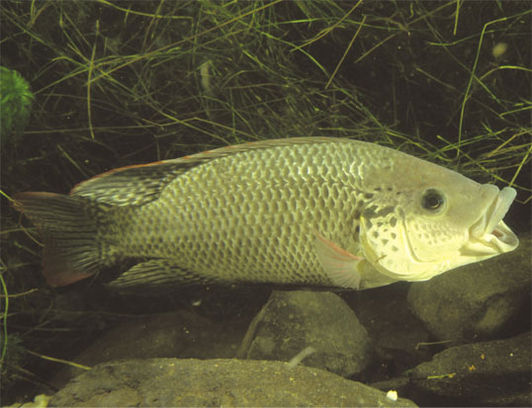
Most animals are said to be stenohaline
And cannot tolerate substantial changes in external osmolarity
Euryhaline animals
Can survive large fluctuations in external osmolarity
Figure 44.2

Slide 6
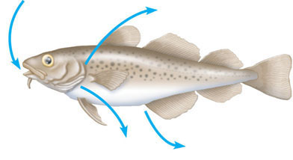
Marine bony fishes are hypoosmotic to sea water
And lose water by osmosis and gain salt by both diffusion and from food they eat
These fishes balance water loss
By drinking seawater
Gain of water and
salt ions from food
and by drinking
seawater
Osmotic water loss
through gills and other parts
of body surface
Excretion of
salt ions
from gills
Excretion of salt ions
and small amounts
of water in scanty
urine from kidneys
Figure 44.3a
(a) Osmoregulation in a saltwater fish

Slide 7
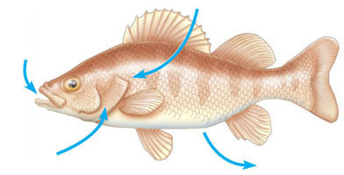
Freshwater animals maintain water balance
By excreting large amounts of dilute urine
Salts lost by diffusion
Are replaced by foods and uptake across the gills
Osmotic water gain
through gills and other parts
of body surface
Uptake of
water and some
ions in food
Uptake of
salt ions
by gills
Excretion of
large amounts of
water in dilute
urine from kidneys
Figure 44.3b
(b) Osmoregulation in a freshwater fish

Slide 8
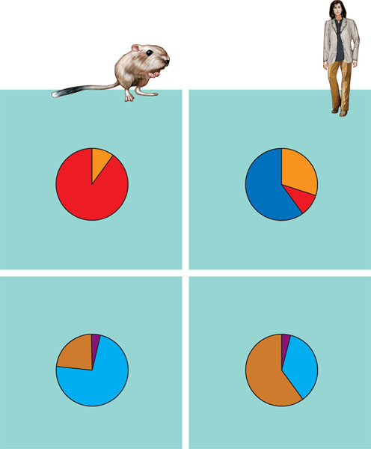
Land Animals
Land animals manage their water budgets
By drinking and eating moist foods and by using metabolic water
Water
balance in a
kangaroo rat
(2 mL/day
= 100%)
Water
balance in
a human
(2,500 mL/day
= 100%)
Ingested
in food (0.2)
Ingested
in food (750)
Ingested
in liquid
(1,500)
Water
gain
Derived from
metabolism (1.8)
Derived from
metabolism (250)
Feces (0.9)
Feces (100)
Urine
(0.45)
Urine
(1,500)
Water
loss
Figure 44.5
Evaporation (1.46)
Evaporation (900)

Slide 9
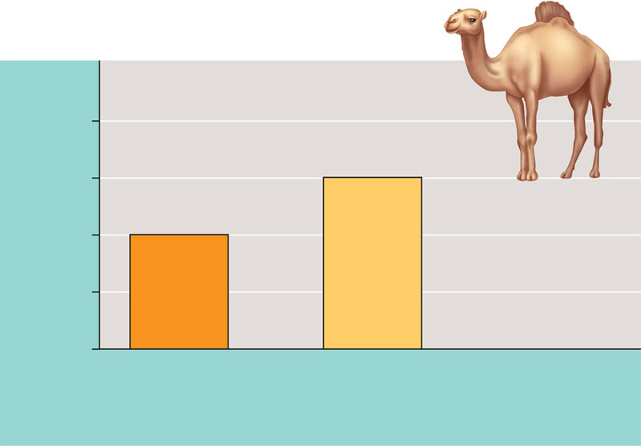
Desert animals
Get major water savings from simple anatomical features
EXPERIMENT
Knut and Bodil Schmidt-Nielsen and their colleagues from Duke University observed that the
fur of camels exposed to full sun in the Sahara Desert could reach temperatures of over 70°C, while the
animals’ skin remained more than 30°C cooler. The Schmidt-Nielsens reasoned that insulation of the skin
by fur may substantially reduce the need for evaporative cooling by sweating. To test this hypothesis, they
compared the water loss rates of unclipped and clipped camels.
Removing the fur of a camel increased the rate of water loss through sweating by up to 50%.
RESULTS
4
3
Water lost per day
(L/100 kg body mass)
2
1
0
CONCLUSION
Control group
(Unclipped fur)
Experimental group
(Clipped fur)
The fur of camels plays a critical role in their conserving water in the hot desert environments where they live.
Figure 44.6

Slide 10
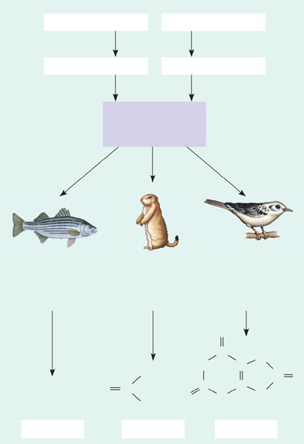
Among the most important wastes
Are the nitrogenous breakdown products of proteins and nucleic acids
Proteins
Nucleic acids
Amino acids
Nitrogenous bases
–NH₂
Amino groups
Most aquatic
animals, including
most bony fishes
Mammals, most
amphibians, sharks,
some bony fishes
Many reptiles
(including
birds), insects,
land snails
O
H
HN
C
C
N
C
NH₂
C
C
C
O
NH₃
O
O
N
N
NH₂
H
H
Figure 44.8
Ammonia
Urea
Uric acid

Slide 11
Urea
The liver of mammals and most adult amphibians
Converts ammonia to less toxic urea
Urea is carried to the kidneys, concentrated
And excreted with a minimal loss of water

Slide 12
Excretory Processes
Most excretory systems
Produce urine by refining a filtrate derived from body fluids
Capillary
Filtration. The excretory tubule collects a filtrate from the blood.
Water and solutes are forced by blood pressure across the
selectively permeable membranes of a cluster of capillaries and
into the excretory tubule.
1
Excretory
tubule
Filtrate
2
Reabsorption. The transport epithelium reclaims valuable substances
from the filtrate and returns them to the body fluids.
Secretion. Other substances, such as toxins and excess ions, are
extracted from body fluids and added to the contents of the excretory
tubule.
3
4
Urine
Excretion. The filtrate leaves the system and the body.
Figure 44.9

Slide 13
Key functions of most excretory systems are
Filtration, pressure-filtering of body fluids producing a filtrate
Reabsorption, reclaiming valuable solutes from the filtrate
Secretion, addition of toxins and other solutes from the body fluids to the filtrate
Excretion, the filtrate leaves the system

Slide 14
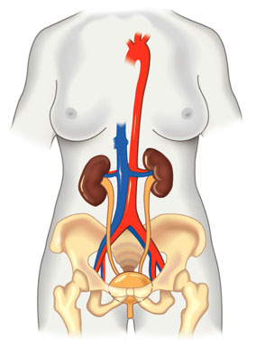
Each kidney
Is supplied with blood by a renal artery and drained by a renal vein
Posterior vena cava
Renal artery and vein
Aorta
Kidney
Ureter
Urinary bladder
Urethra
(a) Excretory organs and major
associated blood vessels
Figure 44.13a

Slide 15
Urine exits each kidney
Through a duct called the ureter
Both ureters
Drain into a common urinary bladder

Slide 16
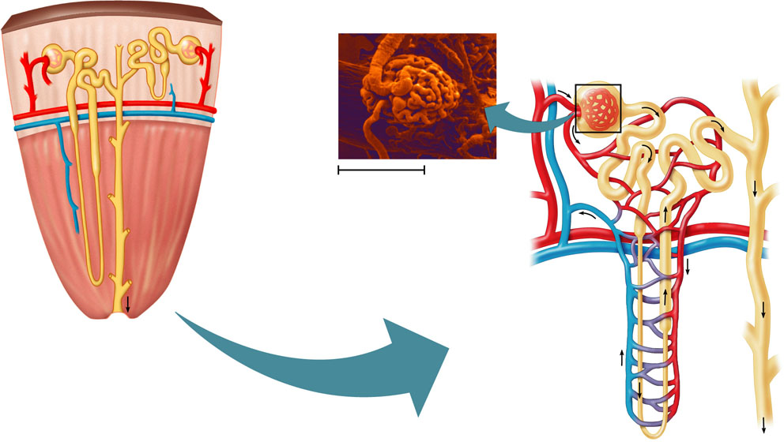
The nephron, the functional unit of the vertebrate kidney
Consists of a single long tubule and a ball of capillaries called the glomerulus
Juxta-
medullary
nephron
Cortical
nephron
Afferent
arteriole
from renal
artery
Glomerulus
Renal
cortex
Bowman’s capsule
Proximal tubule
Peritubular capillaries
Collecting
duct
SEM
20 µm
Renal
medulla
Efferent
arteriole from
glomerulus
Distal
tubule
To
renal
pelvis
Branch of
renal vein
Collecting
duct
Loop
of
Henle
Descending
limb
Ascending
limb
Figure 44.13c, d
Vasa recta
(c) Nephron
(d) Filtrate and
blood flow

Slide 17
Filtration of the Blood
Filtration occurs as blood pressure
Forces fluid from the blood in the glomerulus into the lumen of Bowman’s capsule

Slide 18
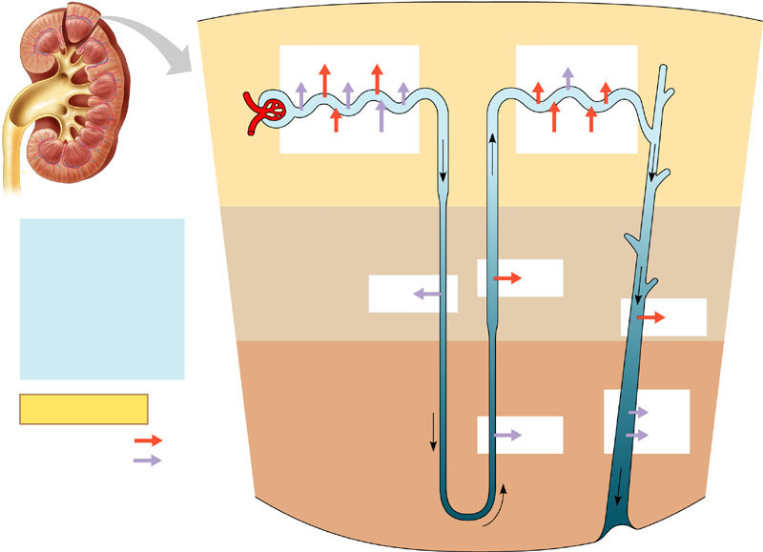
From Blood Filtrate to Urine: A Closer Look
Filtrate becomes urine
As it flows through the mammalian nephron and collecting duct
1
Proximal tubule
4
Distal tubule
NaCl
Nutrients
H₂O
HCO₃
H₂O
K⁺
NaCl
HCO₃
H⁺
NH₃
K⁺
H⁺
CORTEX
Filtrate
2
Descending limb
of loop of
Henle
3
Thick segment
of ascending
limb
H₂O
Salts (NaCl and others)
HCO₃–
H⁺
Urea
Glucose; amino acids
Some drugs
H₂O
NaCl
OUTER
MEDULLA
NaCl
3
Thin segment
of ascending
limb
5
Collecting
duct
Key
Urea
Active transport
NaCl
H₂O
Passive transport
INNER
MEDULLA
Figure 44.14

Slide 19
Concept 44.5: The mammalian kidney’s ability to conserve water is a key terrestrial adaptation
The mammalian kidney
Can produce urine much more concentrated than body fluids, thus conserving water

Slide 20
Regulation of Kidney Function
The osmolarity of the urine
Is regulated by nervous and hormonal control of water and salt reabsorption in the kidneys

Slide 21
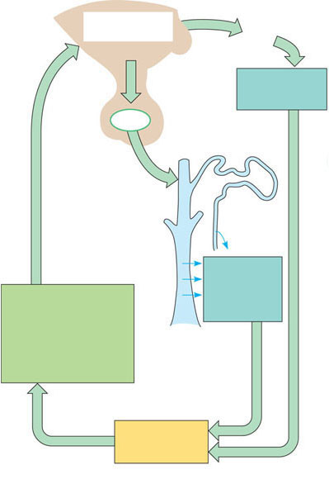
Antidiuretic hormone (ADH)
Increases water reabsorption in the distal tubules and collecting ducts of the kidney
Osmoreceptors
in hypothalamus
Thirst
Hypothalamus
Drinking reduces
blood osmolarity
to set point
ADH
Increased
permeability
Pituitary
gland
Distal
tubule
H₂O reab-
sorption helps
prevent further
osmolarity
increase
STIMULUS:
The release of ADH is
triggered when osmo-
receptor cells in the
hypothalamus detect an
increase in the osmolarity
of the blood
Collecting duct
Homeostasis:
Blood osmolarity
Figure 44.16a
(a) Antidiuretic hormone (ADH) enhances fluid retention by making the kidneys reclaim more water.

Slide 22
The Stomach
The stomach stores food
And secretes gastric juice, which converts a meal to acid chyme
Gastric juice
Is made up of hydrochloric acid and the enzyme pepsin

Slide 23
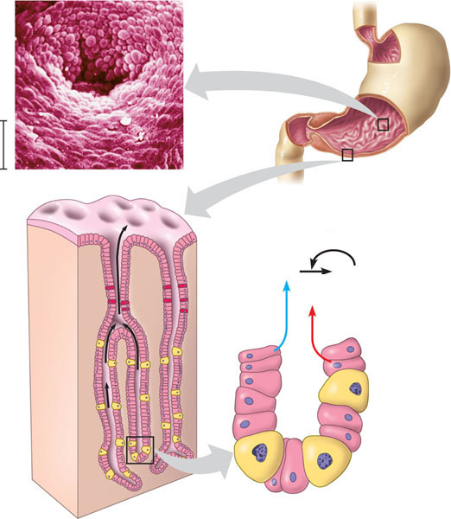
The lining of the stomach
Is coated with mucus, which prevents the gastric juice from destroying the cells
Esophagus
Cardiac orifice
Stomach
Pyloric sphincter
5 µm
Small intestine
Folds of epithelial tissue
Interior surface of stomach.
The interior surface of the stomach wall is highly folded and dotted with pits leading into tubular gastric glands.
Epithelium
3
1
Pepsinogen and HCI
are secreted into the
lumen of the stomach.
Gastric gland. The gastric glands have three types of cells that secrete different components of the gastric juice: mucus cells, chief cells, and parietal cells.
Pepsinogen
Pepsin (active enzyme)
2
HCl
1
2
HCl converts
pepsinogen to pepsin.
Mucus cells secrete mucus,
which lubricates and protects
the cells lining the stomach.
3
Pepsin then activates
more pepsinogen,
starting a chain
reaction. Pepsin
begins the chemical
digestion of proteins.
Chief cells secrete pepsino-
gen, an inactive form of the
digestive enzyme pepsin.
Figure 41.17
Parietal cells secrete
hydrochloric acid (HCl).
Chief cell
Parietal cell

Slide 24
The Small Intestine
The small intestine
Is the longest section of the alimentary canal
Is the major organ of digestion and absorption

Slide 25
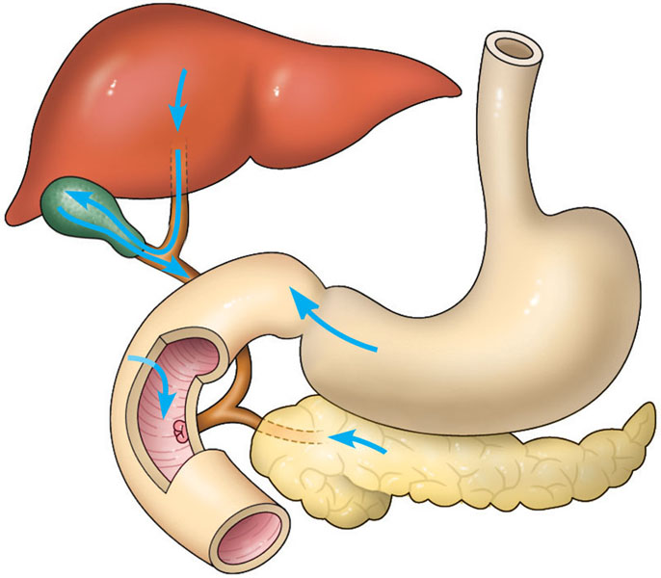
Enzymatic Action in the Small Intestine
The first portion of the small intestine is the duodenum
Where acid chyme from the stomach mixes with digestive juices from the pancreas, liver, gallbladder, and intestine itself
Liver
Bile
Gall- bladder
Stomach
Intestinal juice
Acid chyme
Pancreatic juice
Pancreas
Figure 41.19
Duodenum of small intestine

Slide 26
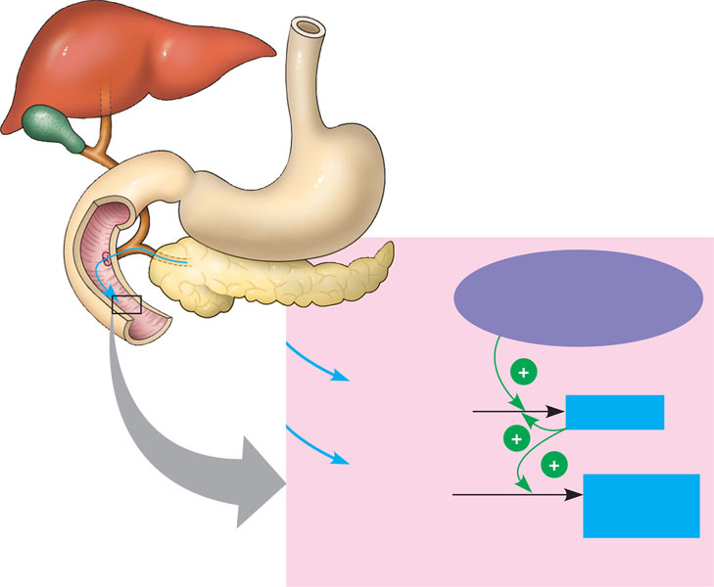
The pancreas produces proteases, protein-digesting enzymes
That are activated once they enter the duodenum
Pancreas
Membrane-bound enteropeptidase
Inactive trypsinogen
Trypsin
Other inactive proteases
Active proteases
Figure 41.20
Lumen of duodenum

Slide 27
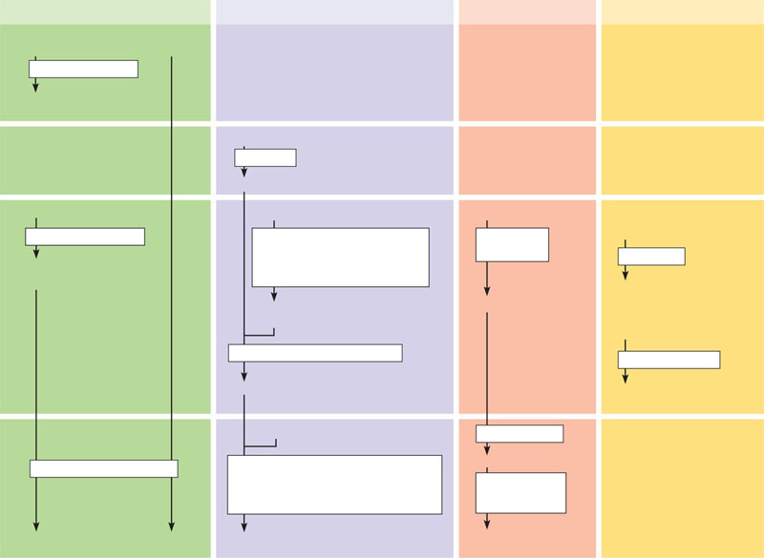
Enzymatic digestion is completed
As peristalsis moves the mixture of chyme and digestive juices along the small intestine
Carbohydrate digestion
Protein digestion
Nucleic acid digestion
Fat digestion
Oral cavity,
pharynx,
esophagus
Polysaccharides
(starch, glycogen)
Disaccharides
(sucrose, lactose)
Salivary amylase
Smaller polysaccharides,
maltose
Stomach
Proteins
Pepsin
Small polypeptides
Lumen of
small intes-
tine
Polysaccharides
Polypeptides
DNA, RNA
Fat globules (Insoluble in
water, fats aggregate as
globules.)
Pancreatic amylases
Pancreatic trypsin and
chymotrypsin (These proteases
cleave bonds adjacent to certain
amino acids.)
Pancreatic
nucleases
Maltose and other
disaccharides
Bile salts
Fat droplets (A coating of
bile salts prevents small drop-
lets from coalescing into
larger globules, increasing
exposure to lipase.)
Smaller
polypeptides
Nucleotides
Pancreatic carboxypeptidase
Pancreatic lipase
Amino acids
Glycerol, fatty
acids, glycerides
Epithelium
of small
intestine
(brush
border)
Small peptides
Nucleotidases
Disaccharidases
Dipeptidases, carboxypeptidase, and aminopeptidase (These proteases split
off one amino acid at a time, working from opposite ends of a polypeptide.)
Nucleosides
Nucleosidases
and
phosphatases
Figure 41.21
Monosaccharides
Amino acids
Nitrogenous bases,
sugars, phosphates

Slide 28
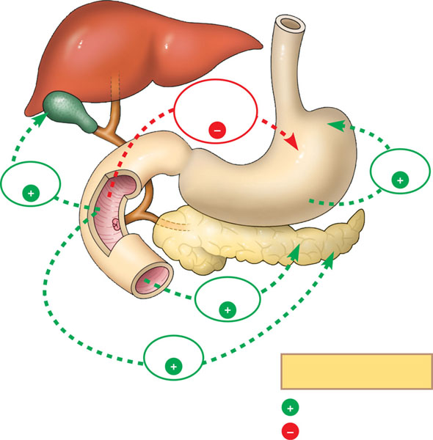
Hormones help coordinate the secretion of digestive juices into the alimentary canal
Enterogastrone secreted by the duodenum inhibits peristalsis and acid secretion by the stomach, thereby slowing digestion when acid chyme rich in fats enters the duodenum.
Liver
Entero-
gastrone
Gall-
bladder
CCK
Gastrin
Gastrin from the stomach recirculates via the bloodstream back to the stomach, where it stimulates the production of gastric juices.
Stomach
Amino acids or fatty acids in the duodenum trigger the release of cholecystokinin (CCK), which stimulates the release of digestive enzymes from the pancreas and bile from the gallbladder.
Pancreas
Duodenum
Secretin
Secreted by the duodenum, secretin stimulates the pancreas to release sodium bicarbonate, which neutralizes acid chyme from the stomach.
CCK
Key
Stimulation
Figure 41.22
Inhibition

