Slide 1
PEDRIGREE CHARTS

Slide 2
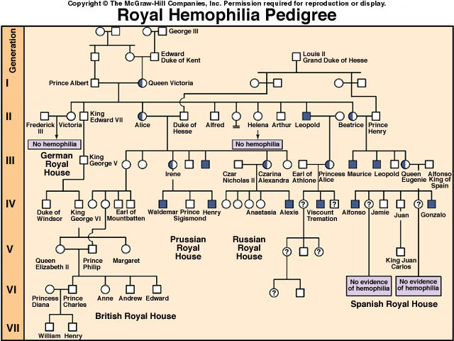

Slide 3
What is a pedigree?
A diagram showing the lineage of an individual so that the inheritance of a trait can be analyzed.
How is this different from a Punnett square??
Pedigree tracks inheritance in actual individuals; Punnett square shows probability of all possible offspring outcomes.

Slide 4
How to read a pedigree
= MALE
= FEMALE
= MARRIED

Slide 5
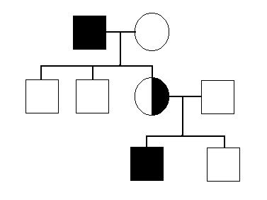
How to read a pedigree
AFFECTED
MALE
NORMAL
FEMALE
CARRIER
FEMALE

Slide 6
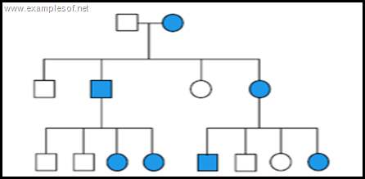
How to read a pedigree
{ }
Affected individuals have what genotype?
DD
Dd
DD
Dd
DD
Dd
Dd
DD
DD
DD
Dd
Dd
DD

Slide 7
How to read a pedigree
{ }
What is this individual’s genotype?
?
DD
Dd
DD
Dd
DD
Dd
Dd
DD
DD
DD
Dd
Dd
DD

Slide 8
How to read a pedigree
{ }
What is this individual’s genotype?
Dd
DD
Dd
DD
Dd
DD
Dd
Dd
DD
DD
DD
Dd
Dd
DD

Slide 9
How to read a pedigree
{ }
Which sex-linked gene causes the disease?
Xa Y
Xb Xb
Xb Y
Xb Y
Xa Xb
Xb Y
Xa Y
Xb Y

