Slide 1
Bell Ringer
What does the word “per” signify in math? Give an example of when you have heard or used “per”.

Slide 2
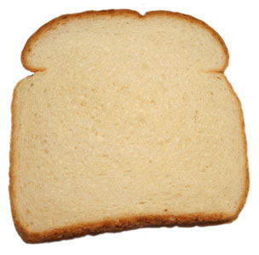
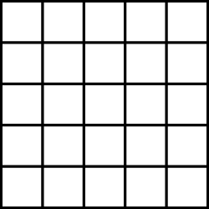
Bell Ringer
You have just dropped your sandwich on the sidewalk outside. You pick up one of the bread slices and notice several small bugs on it. You decide to calculate how many bugs per square inch of bread. Describe the math required to do this.

Slide 3
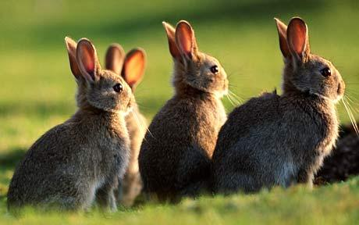
Populations

Slide 4
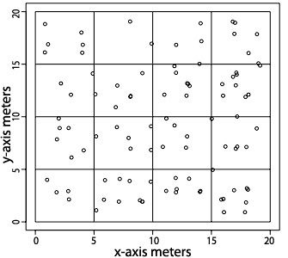
Population Density
The size of a population per unit area
EX: There are 50 rabbits in a 400 m2 field

Slide 5
Population Density
The size of a population per unit area
EX: There are 50 rabbits in a 400 m2 field
What math operation does "per" signify?

Slide 6
Population Density
The size of a population per unit area
EX: There are 50 rabbits in a 400 m2 field
What math operation does "per" signify?
Size of population Area

Slide 7
Population Density
The size of a population per unit area
EX: There are 50 rabbits in a 400 m2 field
What math operation does "per" signify?
50 rabbits 400 m2 = 0.125 rabbits/m2

Slide 8
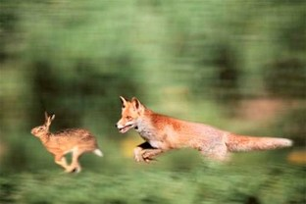
Limiting Factors
Aspects of the environment that limit how much a species population can grow.
Examples:
Availability of resources
Competition
Predation
Climate

Slide 9
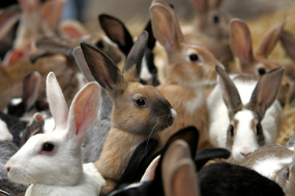
Density-Dependent Factors
Limiting factors whose effect is dependent upon the number of individuals in the population.

Slide 10
Density-dependent Factors
Limiting factors whose effect is dependent upon the number of individuals in the population.
Competition
Predation
Disease
Parasitism

Slide 11
Density-independent Factors
Limiting factors whose effect is the same regardless of population size.

Slide 12
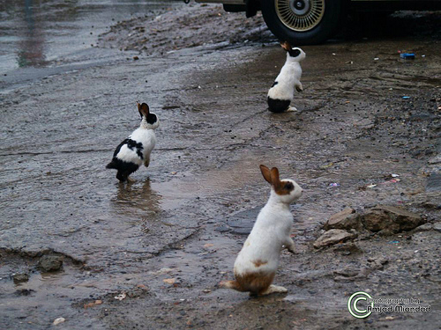
Density-independent Factors
Limiting factors whose effect is the same regardless of population size.
Climate/seasons
Natural disasters
Human impacts (damming, deforestation, etc.)

Slide 13
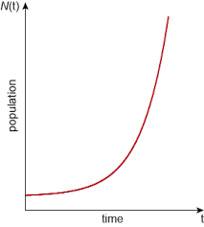
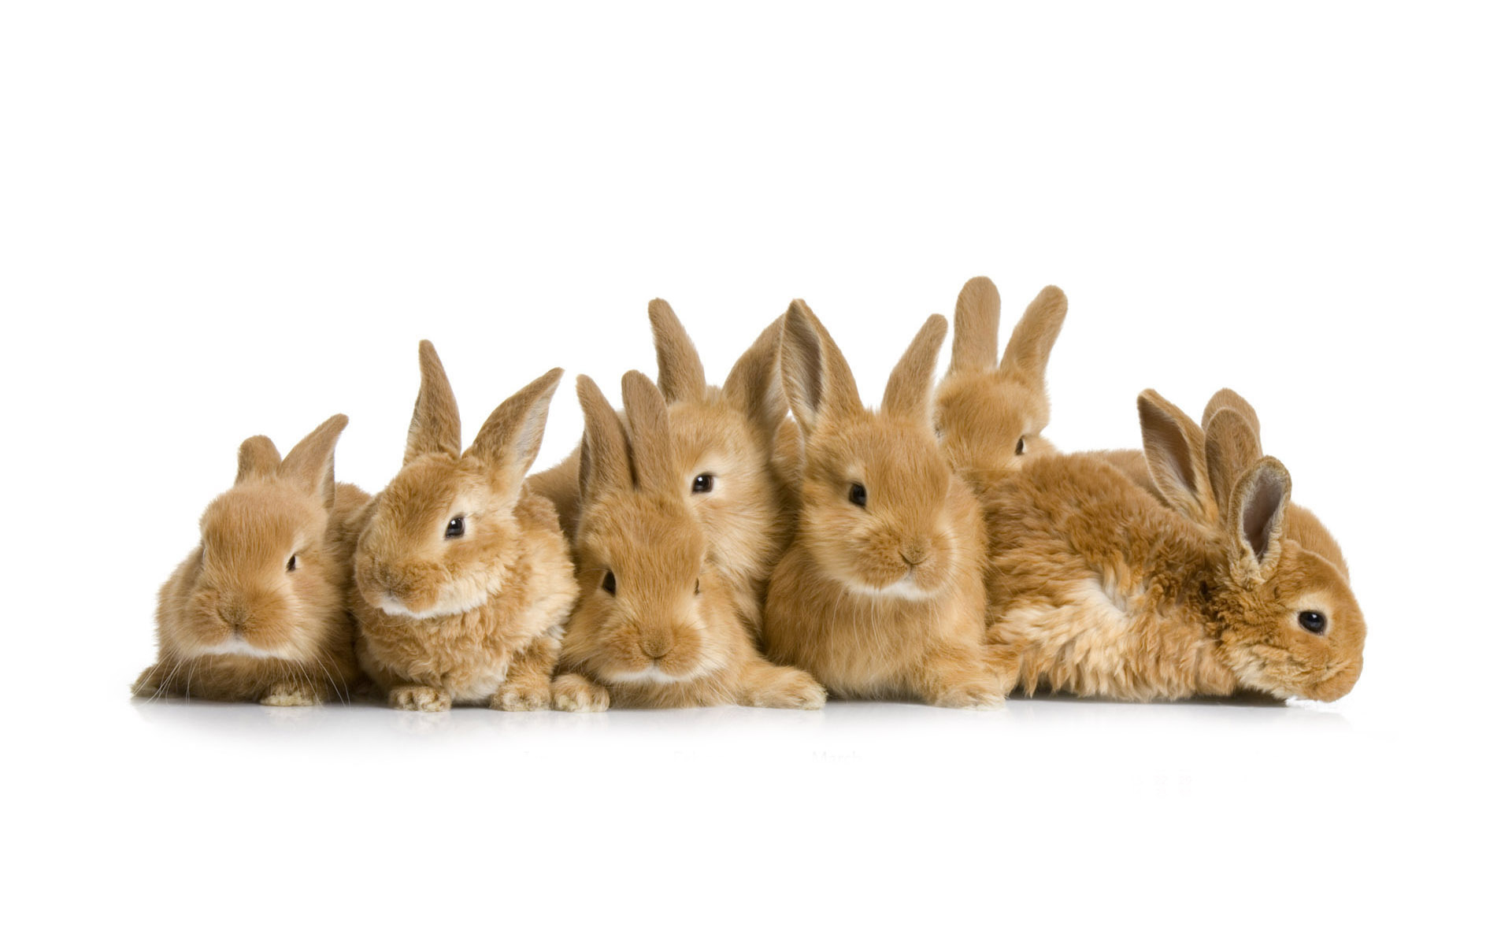
Exponential Growth
When there are few factors to limit the growth of a species its population rapidly increases.

Slide 14
Exponential Growth
Can an environment support exponential growth forever? Why or why not?

Slide 15
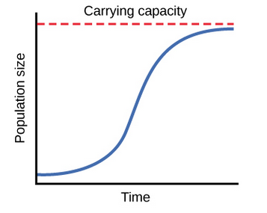
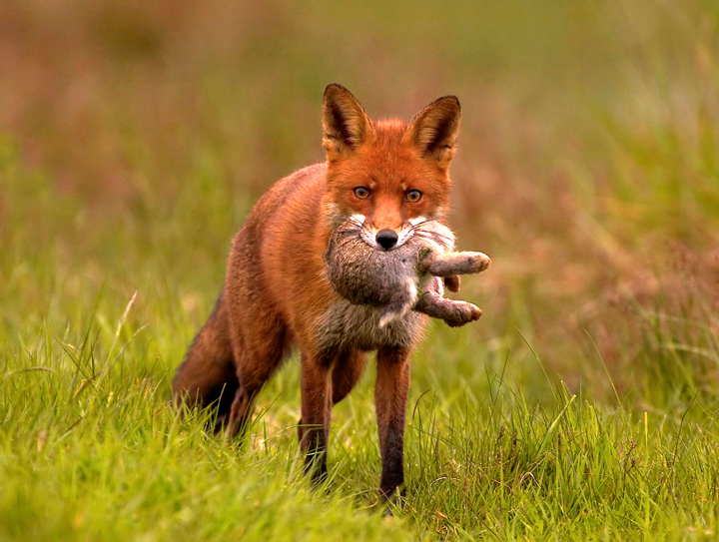
Logistic Growth
When a population is limited by factors such as resource availability, competition, predation, the population size approaches carrying capacity.

Slide 16
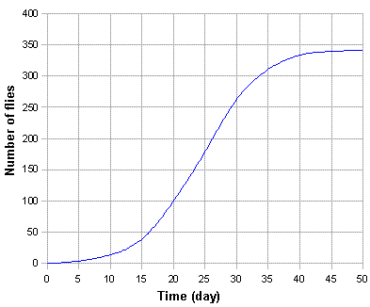
Carrying Capacity
The maximum number of individuals of a species that the environment can sustain.

Slide 17
Carrying Capacity
What is the carrying capacity of flies in this environment?

Slide 18
Carrying Capacity
What is the carrying capacity of flies in this environment?
340

Slide 19
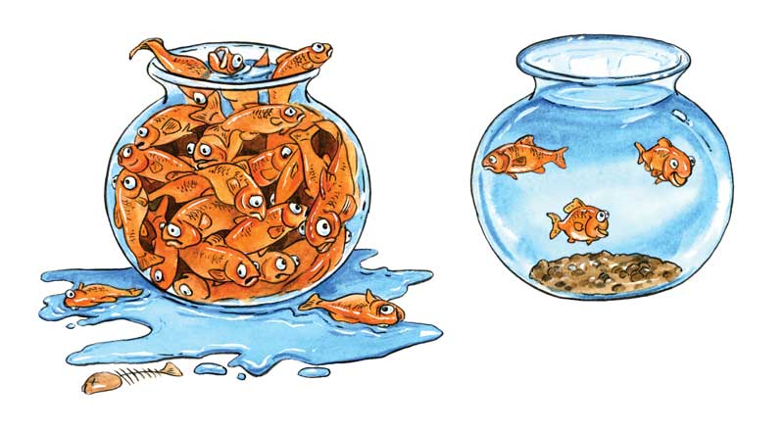
Carrying Capacity
Which environment has exceeded its carrying capacity?

Slide 20
Carrying Capacity
What might happen in an environment that can't support a species population?

Slide 21
Carrying Capacity
What might happen in an environment that can't support a species population?
Population die-off
Diseases
Starvation

