Slide 1
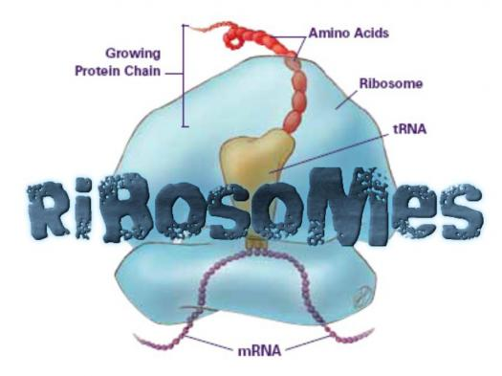
Ribosomes
Virginia Gilliland

Slide 2
Relation of Structure To Function

Slide 3
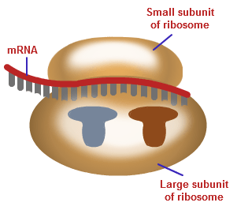
Ribosomes: nonmembranous organelles that make proteins
Made of: rRNA (ribosomal RNA) and protein
Relation to Function: Structure allows protein synthesis to occur
Contains a “large” subunit and a “small” subunit.
These two units bind together with mRNA in between
Allows for the ribosome to read the mRNA (three nucleotides at a time)

Slide 4
Major Process: Protein Synthesis

Slide 5
Protein Synthesis
Transcription: occurs in Nucleus
Transcribe DNA into message making mRNA
mRNA leaves nucleus and travels through cytoplasm to ribosome...
Translation: occurs in Ribosome
Using the mRNA, tRNA has an amino acid (monomer for protein) that matches with coding of mRNA and creates a protein
“Stop codons” tell the ribosome that the protein is finished.

Slide 6
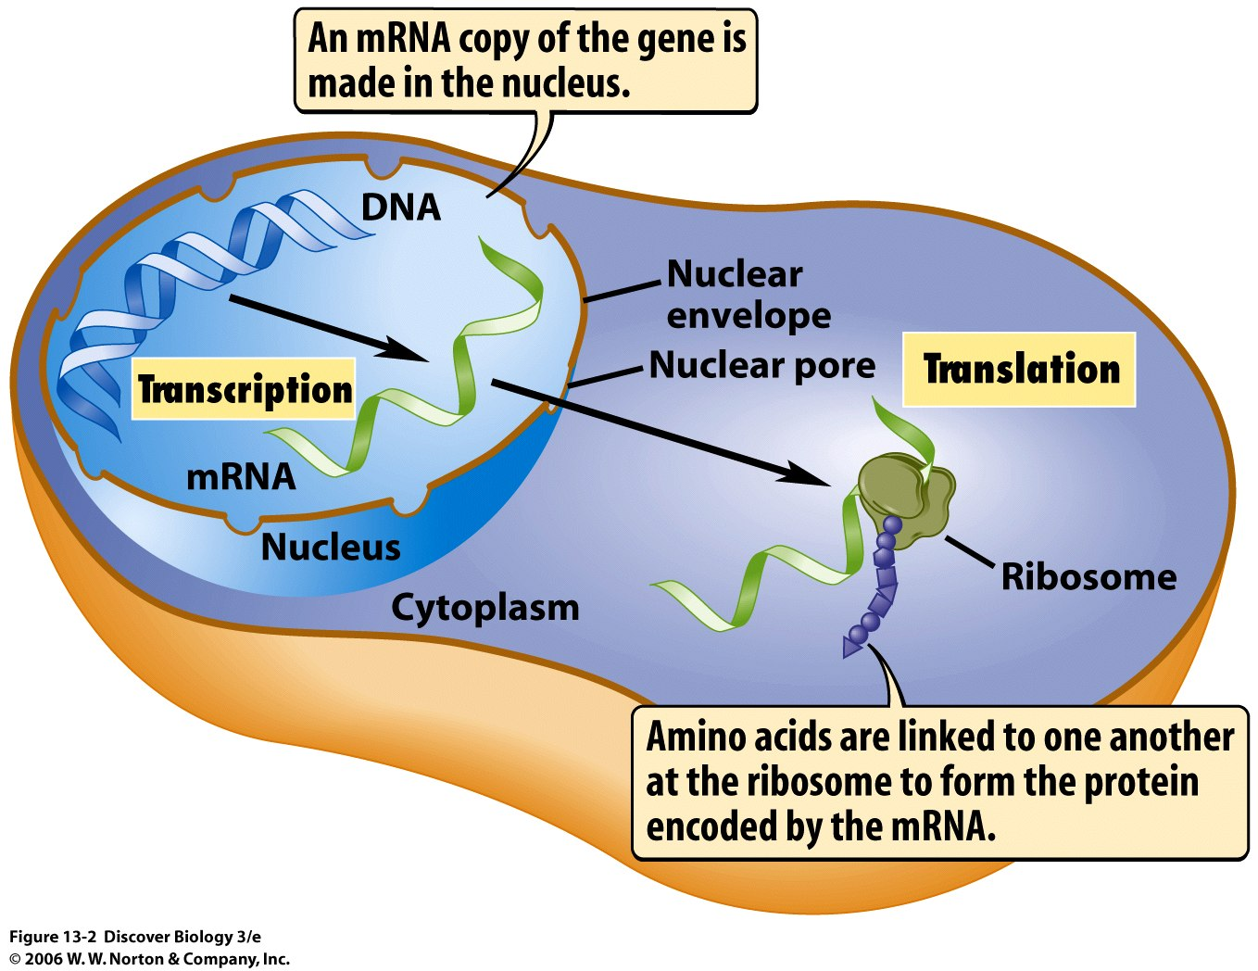
visual of protein synthesis and the function of each structure involved

Slide 7
Interactions With Other Organelles

Slide 8
2 Types of Ribosomes
“Free” = In Cytoplasm
“Bound” = Attached to Rough Endoplasmic Reticulum (ER) or Nuclear Envelope

Slide 9
Attached to Outside of Nuclear Envelope and Endoplasmic Reticulum
Bound Ribosomes Usually...
Make Proteins that are will be inserted into membranes
Make proteins that package with other organelles (ex. lysosome)
Make proteins that can be exported from the cell (Secretion)
Ex. pancreas : Cells of the pancreas excrete digestive enzymes and have high proportions of bound ribosomes

Slide 10
Molecules Used & End Products

Slide 11
mRNA molecules make up the strand of information that leaves the nucleus
tRNA molecules carries amino acid to codon on mRNA
rRNA: part of the structure of ribosomes
End Products: Proteins formed from protein synthesis

Slide 12
Citations
-Goodsell, D. S. (2000, October). Ribosomal Subunits. Retrieved September 18, 2017, from http://pdb101.rcsb.org/motm/10
-University of Utah. (n.d.). Transcribe and Translate a Gene. Retrieved September 18, 2017, from http://learn.genetics.utah.edu/content/basics/transcribe/
-Campbell, N. A., & Reece, J. B. (2005). AP Edition Biology(7th ed.). San Francisco, CA: Pearson.

