Slide 1
Sickle Cell Anemia
By: Sapphire Bowen-Kauth
Barksdale, AP Biology ½ Period, 15 November 2016

Slide 2
Introduction

Slide 3
History of the Discovery of Sickle Cell Anemia
Has been present in Africa for nearly 5,000 years, but referred to under tribal names
1910- regarded as the year of discovery by Dr. James B. Herrick and Dr. Ernest Irons (first time the disorder was referred to as “sickle cells”)
1927- Hahn and Gillespie discovered that cells sickle when oxygen is removed and “sickle cell trait”
1951-Dr. Linus Pauling and his colleague Dr. Harvey Itano discovered that the red, oxygen-carrying protein called “hemoglobin” had a different chemical structure

Slide 4
Targeting a Certain Population
In the U.S. mostly affects people of African ancestry
Geographic distribution of the sickle cell gene is similar to that of the malaria infection
A selective advantage against malaria?
What is malaria does not pose as a threat?
Hispanic, southern European, Middle Eastern, or Asian Indian backgrounds are also affected

Slide 5
Cases of Sickle Cell Anemia
70,000-100,000 Americans have sickle cell anemia
1 out of every 365 Black or African-American births.
1 out of every 16,300 Hispanic-American births.
1 in 13 Black or African-American babies births
Sickle cell anemia is the most common form of an inherited blood disorder causing the production of abnormal hemoglobin.

Slide 6
Description

Slide 7
Signs
Complaints of severe (quick -longstanding episodes of pain)
Hand-foot syndrome-sudden onset of a painful swelling of the back of the hands and feet
Jaundice
Fatigue
Delayed Growth

Slide 8
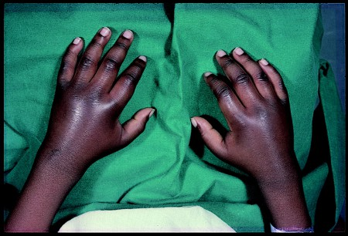
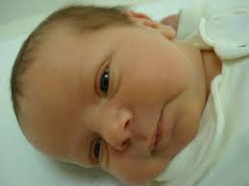
Signs

Slide 9
Symptoms
Symptoms vary between carriers of the disease-may have as little as one infarction per year, but others may bear over a dozen pain episodes that sustain for days or weeks
Hemolytic anemia
Infarctions (Pain Crises)
Severe bone pain
Reduced blood flow
Ulcers on joints- leading to cell death
Damage to internal organs (especially kidneys)

Slide 10
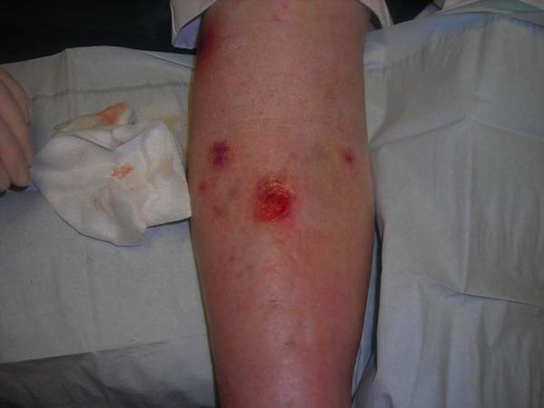
Symptoms

Slide 11
Prognosis
Increased propensity for infections
intermittent pain crises, fatigue, bacterial infections, and progressive tissue and organ damage
Physical and emotional trauma that is endured by children and adults
Causes of death include bacterial infection (the most common cause), stroke or bleeding into the brain, and kidney, heart, or liver failure.
The current average life expectancy of a person living with sickle cell disease in the United States is between 40 and 60 years.

Slide 12
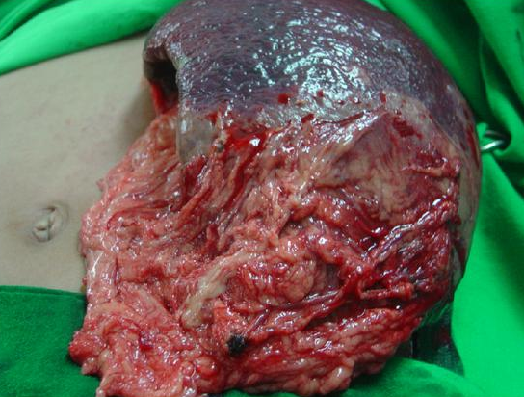
Prognosis

Slide 13
Inheritance

Slide 14
Normal Red Blood Cells vs. Sickled Red Blood Cells
Normal Red Blood Cells
Round, curved shaped cells made up of hemoglobin which carries oxygen
Cells live 120 days
Referred to as AA
Sickled Red Blood Cells
Sickle cell hemoglobin can form stiff rods within the red blood cell
Forms a into a crescent form
Inflexible and an attach to vessel walls
Blockage will slow or halt blood flow
Cells live 10-12 days
Referred to as AS or SS

Slide 15
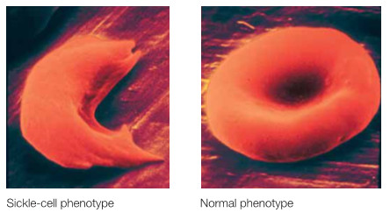
Normal Red Blood Cells vs. Sickled Red Blood Cells

Slide 16
Mutations
Qualitative mutations- mutations in the globin genes that alter the protein composition but not necessarily the amount of expression
single nucleotide substitution (A to T) in the codon for amino acid 6
converts a glutamic acid codon (GAG) to a valine codon (GTG) on chromosome 11

Slide 17
Mutations
Form of hemoglobin in persons with sickle cell anemia is referred to as HbS (HBB glu6val, GAG —> GTG, sickle hemoglobin, HbS)
Valine for glutamic acid substitution= hemoglobin tetramers that aggregate into arrays upon deoxygenation in the tissues
Polymerize into intracellular fibers, forming a high molecular weight gel

Slide 18
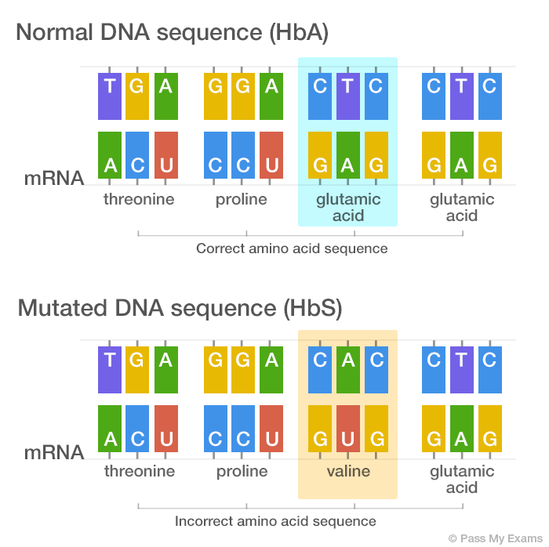
Mutations

Slide 19
Mode of Inheritance
Autosomal recessive disorder
Sickle cell anemia- full disease symptoms to manifest in an individual they must carry two copies (homozygous genotype = SS) of the HbS gene
Sickle cell trait- presence of one sickle cell allele can affect the phenotype of the red blood cell
Individuals who are heterozygous (genotype = AS) have a phenotypically dominant trait yet are recessive genotypically

Slide 20
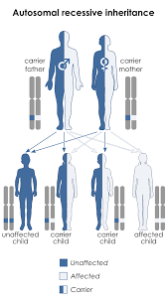
Mode of Inheritance

Slide 21
Treatment

Slide 22
Treatment
Lead a healthy lifestyle full of exercise and a nutritious diet
Antibiotics
Pain-relieving medications
Blood transfusions
Supplemental oxygen
Gene therapy- inserting a normal gene into the bone marrow
Nitric oxide-open blood vessels
Hydroxyurea-reduces number of infarctions
Bone marrow transplant

Slide 23
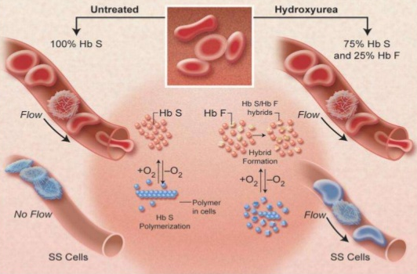
Treatment

Slide 24
A Possible Cure
Currently no cure for sickle cell anemia
Hematopoietic stem cell transplantation is the only potential cure but requires a well-matched donor in closeness to age.
Increased research is being done on stem cell transplants for adults

Slide 25
Prevention

Slide 26
Prevention-Not Necessarily
Genetic counseling can be helpful for parents and families to prevent sickle cell anemia.
If each parent is a carrier, any child has a one chance in two (50%) of also being a carrier and a one in four (25%) chance of inheriting both genes from the parents and being affected with sickle cell anemia

Slide 27
Latest Screening Tests
Early diagnosis by newborn screening and a sickle cell disease test are imperative
Clinical manifestations become evident in four to six months of a baby’s life or not until the age of three or four years old
blood count of erythrocytes and hemoglobin
HbS solubility
Genetic classification
Blood tests

Slide 28
Works Cited
Campbell, N. A., & Reece, J. B. (2005). Preparing for the Biology AP Exam with
Biology, Seventh Edition (7th ed.). San Francisco, Ca.: Pearson/Benjamin
Cummings.
King, M. W., PhD. (2015, June 3). Sickle Cell Anemia. Retrieved November 15, 2016, from
http://themedicalbiochemistrypage.org/sicklecellanemia.php
Sickle Cell Anemia. (2014, June 11). Retrieved November 15, 2016, from
http://www.mayoclinic.org/diseases-conditions/sickle-cell-anemia/basics/treatment/con-20019348
Steinberg, M. H., MD. (2016, February 12). Clinical variability in sickle cell anemia (S. L. Schrier MD, Ed.). Retrieved
November 16, 2016, from
https://www.uptodate.com/contents/clinical-variability-in-sickle-cell-anemia?source=search_result&sea
rch=who%2Bis%2Baffected%2Bby%2Bsickle%2Bcell%2Banemia&selectedTitle=1~150
What Is Sickle Cell Disease? (2016, August 2). Retrieved November 15, 2016, from
https://www.nhlbi.nih.gov/health/health-topics/topics/sca
What is Sickle Cell Disease? (2016, September 14). Retrieved November 15, 2016, from
http://www.healio.com/hematology-oncology/hematology/news/online/%7Bf1bbbe8d-1052-4de6-a69f-f81b011
3bc30%7D/what-is-sickle-cell-disease?gclid=CIaXjML9q9ACFUpWDQodRgYC1w
Winter, W. P., PhD. (n.d.). A Brief History of Sickle Cell Disease. Retrieved November 15, 2016, from
http://www.sicklecell.howard.edu/ABriefHistoryofSickleCellDisease.htm

