Slide 1
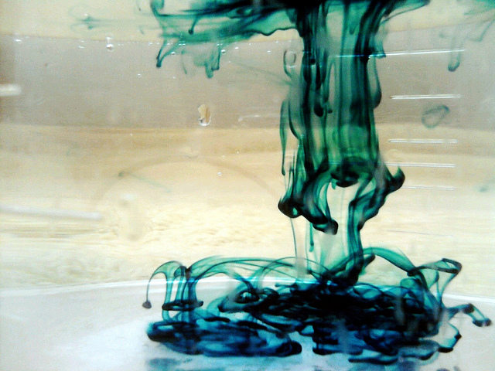
TYPES OF TRANSPORT

Slide 2
Molecular Movement
Molecules move RANDOMLY!

Slide 3
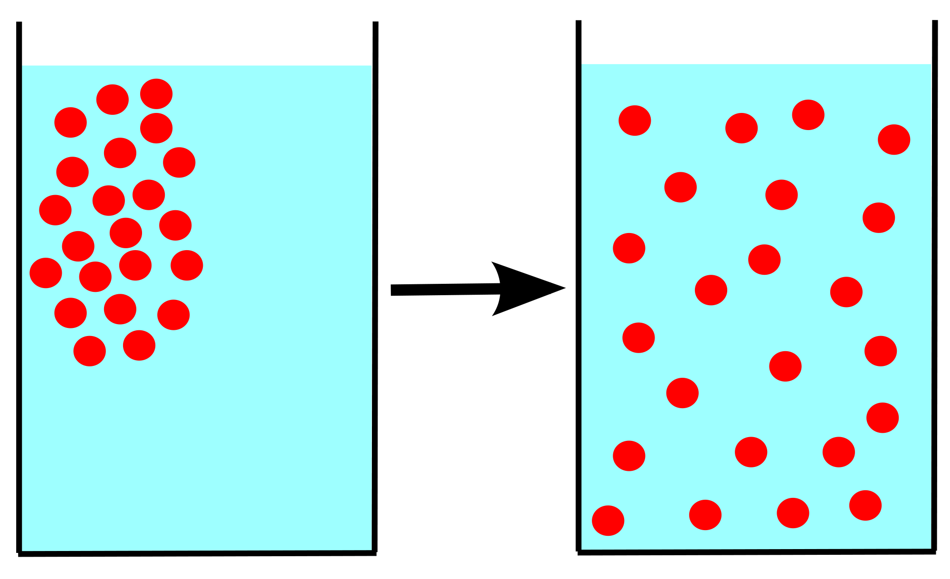
Diffusion
…is the random movement of particles from an area of high concentration to low concentration.

Slide 4
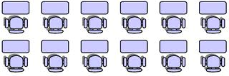
Diffusion in the air

Slide 5
Diffusion in the air
Low concentration
High concentration

Slide 6
Diffusion in the air

Slide 7
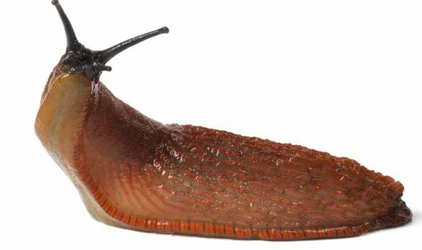
Water can also diffuse
Salt on a slug

Slide 8
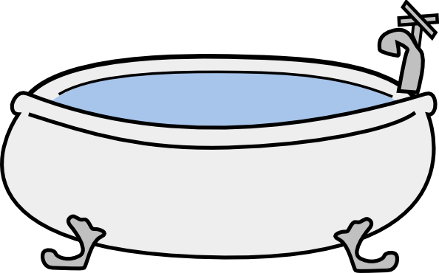
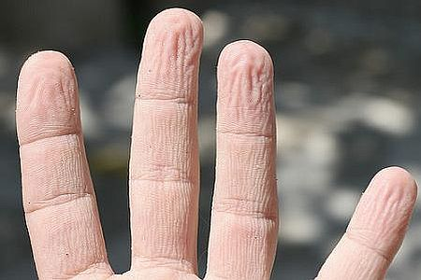
Water can also diffuse
Pruney fingers
WATER

Slide 9
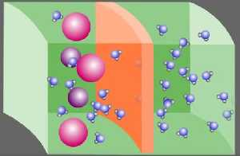
Osmosis
The diffusion of water across a semi-permeable membrane.
Semi-permeable = some things can pass, others cannot

Slide 10
Osmosis
The diffusion of water across a semi-permeable membrane.
Semi-permeable = some things can pass, others cannot
CELL MEMBRANES ARE SEMI-PERMEABLE!

Slide 11
Passive transport
Molecules can move into or out of a cell without energy input from the cell.
Ex: diffusion and osmosis, facilitated diffusion

Slide 13
Facilitated Diffusion
Another type of passive transport
Proteins in the cell membrane help to move molecules into/out of the cell

Slide 15
Active transport
Energy input from the cell is required for a membrane protein to help molecules to move into/out of the cell
Energy provided from ATP molecules
Active transport usually required to make molecules go against their concentration gradient

Slide 16
